Slide 1

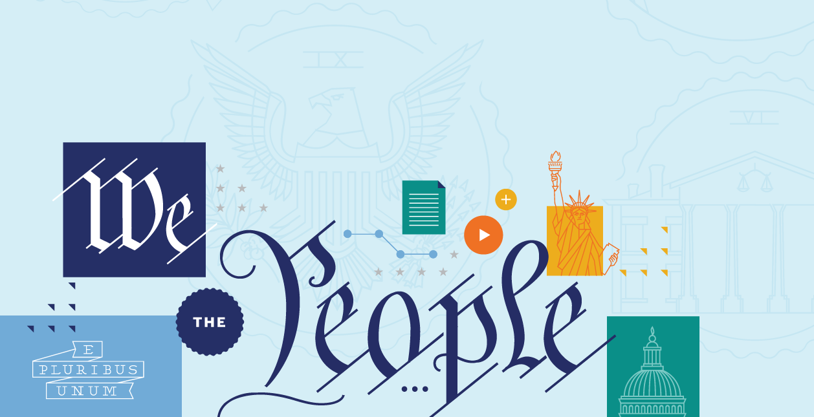

Slavery in America: The Constitution to Reconstruction
Slavery in America – From the Constitution to the Civil War

Slide 2
Framing Questions
Slavery was embedded into America’s fabric by the time of the ratification of the Constitution. Did this affect how long slavery lasted in America and how it ended?
The 13th, 14th, and 15th Amendments ended slavery in America and tried to rebuild our nation on a stronger constitutional foundation. Did these amendments change the Constitution so much that it was like a re-birth—a “Second Founding”—of our nation?
Slavery in America – From the Constitution to the Civil War

Slide 3
Big Idea
While the original Constitution—plus the Bill of Rights—remains a powerful statement of many of America’s most enduring principles, the Thirteenth, Fourteenth, and Fifteenth Amendments truly represent our nation’s “Second Founding.”
Slavery in America – From the Constitution to the Civil War

Slide 4
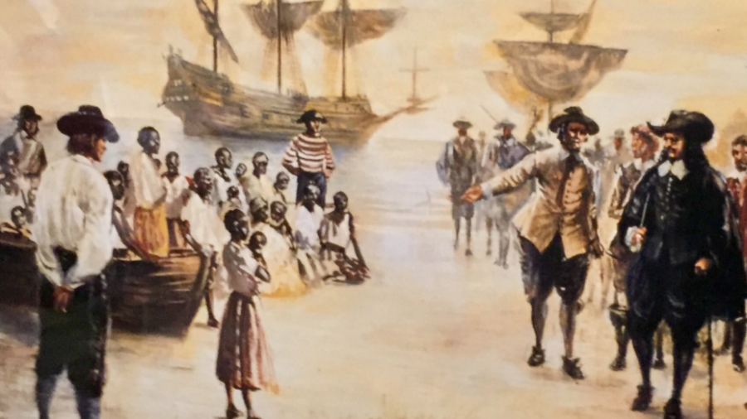
slavery in the colonies
Slavery in America – From the Constitution to the Civil War

Slide 5
slavery in the colonies
Slavery itself was written into colonial law as early as the 1660s in places like Virginia and the Carolinas.
By the 1700s, these colonial slave codes transformed slavery itself—making it inheritable. In other words, it was passed down from mother to child and was a lifelong condition based on race.
This was known as “chattel slavery.” And this was a fundamental shift in how the institution of slavery worked.
Slavery in America – From the Constitution to the Civil War

Slide 6
slavery in the colonies
The push towards emancipation—the end of slavery—in the North:
Vermont ended slavery in their 1777 constitution.
A state supreme court decision ended slavery in Massachusetts in 1783.
Pennsylvania passed a gradual emancipation bill in 1780, followed by Rhode Island and Connecticut in 1784.
Slavery in America – From the Constitution to the Civil War

Slide 7
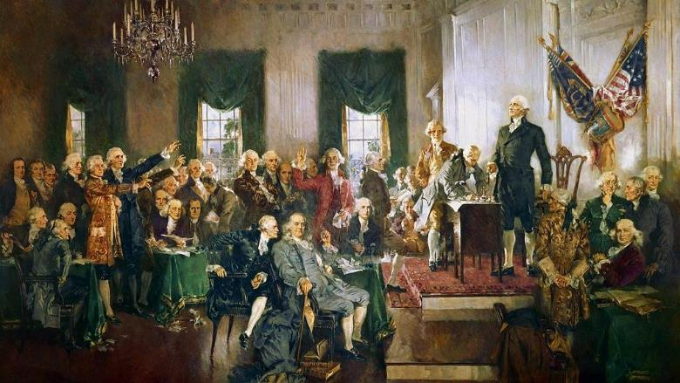
The Constitutional Convention
Slavery in America – From the Constitution to the Civil War
25 of the 55 convention delegates were slaveholders (roughly 45%), and slavery was critical to many of these delegates’ wealth—and to the economies of their home states.

Slide 8
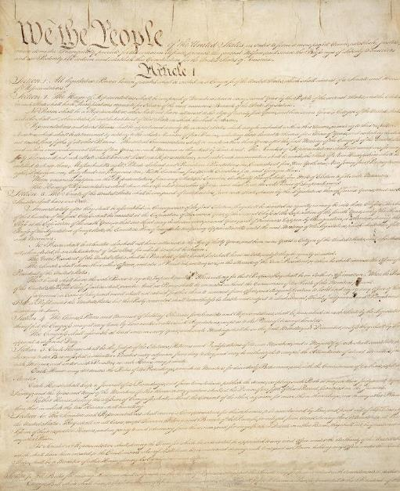
The Constitution
Three-Fifth Clause
Fugitive Slave Clause
Slave Trade Clause
Slavery in America – From the Constitution to the Civil War

Slide 9
The “Three-fifths Clause”
Article I, Sect. II, Cl. 3
Slavery in America – From the Constitution to the Civil War
“Representatives and direct Taxes shall be apportioned among the several States which may be included within this Union, according to their respective Numbers, which shall be determined by adding to the whole Number of free Persons, including those bound to Service for a Term of Years, and excluding Indians not taxed, three fifths of all other Persons.”

Slide 10
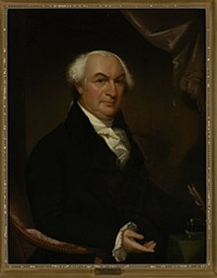
The “Three-fifths Clause”
Pennsylvania delegate Gouverneur Morris called slavery a “nefarious institution— . . . the curse of heaven on the states where it prevailed.”
Slavery in America – From the Constitution to the Civil War
Gouverneur Morris

Slide 11
The “Three-fifths Clause”
Morris then attacked the Three-Fifths Clause, “Upon what principle is it that the slave should be computed in the representation? Are they men? Then make them citizens and let them vote. Are they property? Why then is no other property included?”
Slavery in America – From the Constitution to the Civil War
Gouverneur Morris

Slide 12
The “Three-fifths Clause”
“The admission of slaves into the representation when fairly explained comes to this”—that “the inhabitant of Georgia and South Carolina who goes to the Coast of Africa, and in defiance of the most sacred laws of humanity tears away his fellow creatures from their dearest connections and dooms them to the most cruel bondages, . . . receives more votes in a government instituted for the protection of the rights of mankind, than the citizen of Pennsylvania or New Jersey who views with a laudable horror so nefarious a practice.”
Slavery in America – From the Constitution to the Civil War
Gouverneur Morris

Slide 13
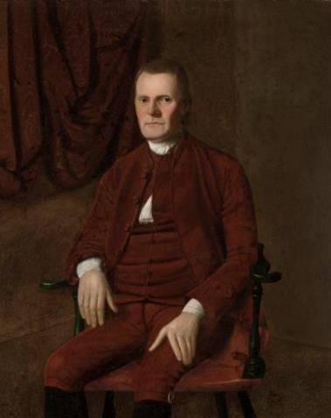
The “Three-fifths Clause”
Ultimately, Roger Sherman of Connecticut secured support for the Three-Fifth Clause. Of course, the Framers avoided using the word “slave” in the Clause.
Slavery in America – From the Constitution to the Civil War
Roger Sherman

Slide 14
The “Three-fifths Clause”
In the end, this Clause had a huge impact over time.
The Three-Fifths Clause increased pro-slavery strength in Congress (by counting enslaved people as 3/5 of a person), in the Presidency (through the Electoral College), and at the Supreme Court (through electing pro-slavery Presidents, who appoint those Justices).
Slavery in America – From the Constitution to the Civil War

Slide 15
The “Fugitive Slave” Clause
Article IV, Sect. II, Cl. 3
Slavery in America – From the Constitution to the Civil War
“No Person held to Service or Labour in one State, under the Laws thereof, escaping into another, shall, in Consequence of any Law or Regulation therein, be discharged from such Service or Labour, but shall be delivered up on Claim of the Party to whom such Service or Labour may be due.”

Slide 16
The Slave Trade Clause
Article I, Sect. IX, Cl. 1
Slavery in America – From the Constitution to the Civil War
“The Migration or Importation of such Persons as any of the States now existing shall think proper to admit, shall not be prohibited by the Congress prior to the Year one thousand eight hundred and eight, but a Tax or duty may be imposed on such Importation, not exceeding ten dollars for each Person.”

Slide 17
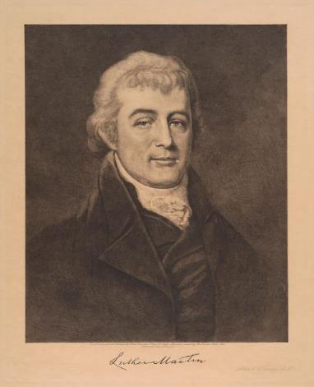
The Slave Trade Clause
Maryland’s Luther Martin attacked the international slave trade as “inconsistent with the principles of the Revolution, and dishonorable to the American character.”
Slavery in America – From the Constitution to the Civil War
Luther Martin

Slide 18
The Slave Trade Clause
In response, here’s John Rutledge of South Carolina:
“Religion and humanity had nothing to do with this question. Interest alone is the governing principle with nations. The true question, at present, is whether the Southern states shall or shall not be parties to the Union. If the Convention thinks that NC, SC, and GA will ever agree to the plan, unless their right to import slaves be untouched, that expectation is in vain. The people of those states will never be such fools as to give up so important an interest.”
Slavery in America – From the Constitution to the Civil War
John Rutledge

Slide 19
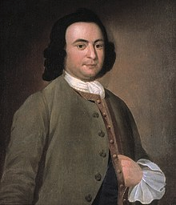
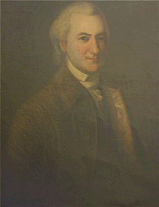
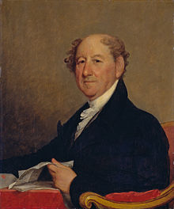
The Slave Trade Clause
Slavery in America – From the Constitution to the Civil War
George Mason
John Dickinson
Rufus King
George Mason, John Dickinson, and Rufus King proposed an outright ban on the Atlantic slave trade, but the delegates rejected it.

Slide 20
The Slave Trade Clause
Instead, the Convention reached a compromise over the slave trade. Congress could ban the slave trade, but only twenty years after the ratification of the Constitution—January 1, 1808.
In other words, this Clause protected the brutal slave trade until 1808.
Between 1788 and 1808, the number of enslaved people imported into the United States exceeded 200,000—only roughly 50,000 fewer than the total number of enslaved people imported to American in the previous 170 years.
In 1808, Congress finally had the power to abolish the international slave trade. And so it did.
Slavery in America – From the Constitution to the Civil War

Slide 21
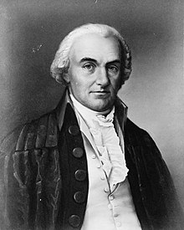
“Slavery, in time, will not be a speck in our country.”
Slavery in America – From the Constitution to the Civil War
Oliver Ellsworth

Slide 22
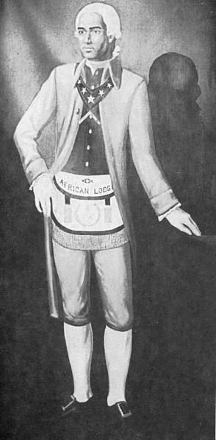
Early Anti-Slavery Movements
Prince Hall—a free African American in Boston—offered a petition for freedom to the Massachusetts House on behalf of seven African Americans. The petition drew on the Declaration of Independence, arguing that slavery violates natural law.
Massachusetts’s highest court would go on to declare slavery unconstitutional in 1783—answering Prince Hall’s prophetic call.
Slavery in America – From the Constitution to the Civil War
Prince Hall

Slide 23
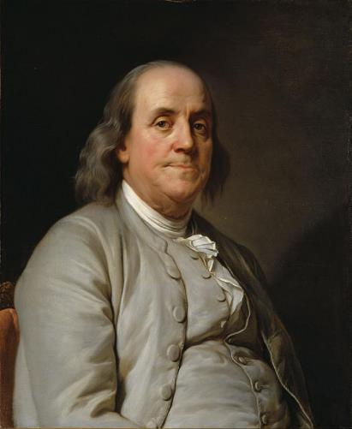
Early Anti-Slavery Movements
Pennsylvania had the first abolition society in the country—founded in April 1775. The Quakers took a lead role in the society.
A decade later, Benjamin Franklin was elected the Society’s president. In his final public act, he sent a petition—signed in February 1790—to Congress on behalf of the Pennsylvania Abolition Society, calling for the abolition of slavery and an end to the slave trade.
Slavery in America – From the Constitution to the Civil War
Benjamin Franklin

Slide 24
Early Anti-Slavery Movements
It called for the First Congress to “devise a means for removing the Inconsistency from the Character of the American People” and “to promote mercy and justice towards this distressed Race”—namely, African Americans.
Congress concluded the Constitution limited its power to end the slave trade until 1808.
Slavery in America – From the Constitution to the Civil War
Benjamin Franklin

Slide 25
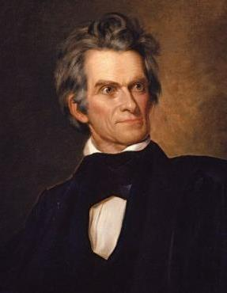
Lead up to The Civil War
Prior to the Civil War, both pro-slavery and anti-slavery advocates debated the Constitution’s meaning and its relationship to slavery. Several different visions emerged.
Pro-slavery advocates like John C. Calhoun looked to the Constitution’s text and history and argued that the Constitution was a pro-slavery document.
Slavery in America – From the Constitution to the Civil War
John C. Calhoun

Slide 26
Abolitionism
Abolitionism was an interracial movement, bringing African American and white Americans together in a common cause. African American and white Northerners—women and men, alike—increasingly joined anti-slavery societies over time.
Their members sent petitions to Congress, pressed state legislatures to pass laws that protected the rights of alleged fugitives, and organized to resist slavecatchers and kidnappers.
As the decades advanced, a wide range of abolitionist and anti-slavery thought emerged as the country grappled with how to deal with slavery.
Slavery in America – From the Constitution to the Civil War

Slide 27
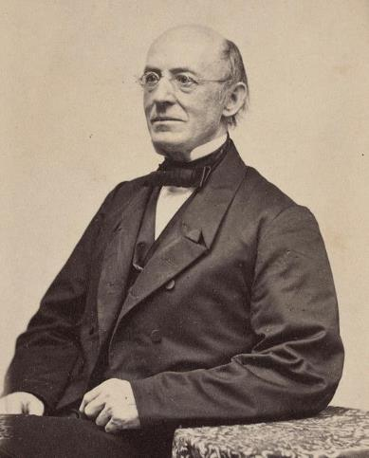
Garrison Interpretation
The Garrisonians or “radical abolitionists”—including William Lloyd Garrison and Wendell Phillips—maintained that the Constitution was “a covenant with death and an agreement with hell.” Ironically, Phillips, Garrison, and their supporters agreed with pro-slavery advocates like Calhoun.
They argued that the Constitution was a pro-slavery compact.
Slavery in America – From the Constitution to the Civil War
William Lloyd Garrison

Slide 28
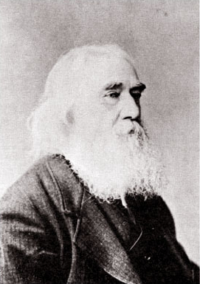
Anti-Slavery Constitution
Other anti-slavery advocates opposed the Garrisonian vision and argued that the Constitution gave anti-slavery forces the power they needed to end slavery.
For instance, anti-slavery advocates like Lysander Spooner rejected the Garrisonian argument and countered with a vision of the Constitution as a fundamentally anti-slavery document.
Slavery in America – From the Constitution to the Civil War
Lysander Spooner

Slide 29
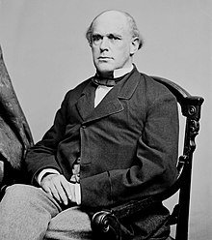
Anti-Slavery Constitution
A group led by Salmon P. Chase—the future Chief Justice—adopted the view that, while the Constitution didn’t empower the national government to attack slavery where it already existed in the slaveholding states, the federal government was free to abolish slavery in the District of Columbia, in the territories, and on all federal property.
Slavery in America – From the Constitution to the Civil War
Salmon P. Chase

Slide 30
Anti-Slavery Constitution
Scholars sometimes call this group the “political abolitionists” for its willingness to engage in electoral politics to achieve the end of slavery.
Their slogan was “Freedom National, Slavery Local.”
They sought to limit the spread and influence of slavery in the hopes that it might eventually die out without war or the end of the Union.
This stance became the constitutional platform of the Liberty Party, the Free Soil Party, and eventually Lincoln’s Republican Party.
Slavery in America – From the Constitution to the Civil War

Slide 31
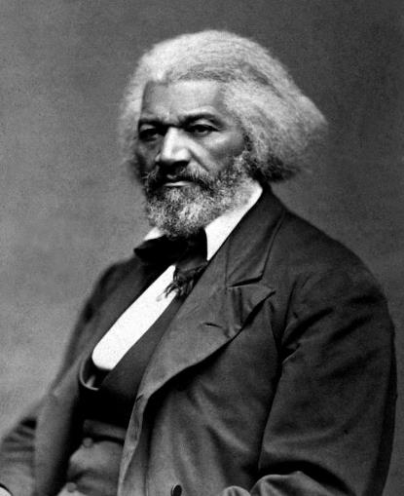
Frederick Douglass
Douglass was one of the most powerful (and influential) anti-slavery voices in pre-Civil War America.
Douglass began as a Garrisonian, but later changed his mind.
In a famous 1860 speech, Douglass read the Constitution’s text as a “glorious liberty document.”
Slavery in America – From the Constitution to the Civil War
Frederick Douglas

Slide 32
Frederick Douglass
“Its language is ‘we the people.’ Not we the white people, not even we the citizens, not we the privileged class, not we the high, not we the low, but we the people.”
Slavery in America – From the Constitution to the Civil War
Frederick Douglas

Slide 33
Frederick Douglass
“If the South has made the Constitution bend to the purposes of slavery, let the North now make that instrument bend to the cause of freedom and justice.”
Slavery in America – From the Constitution to the Civil War
Frederick Douglas

Slide 34
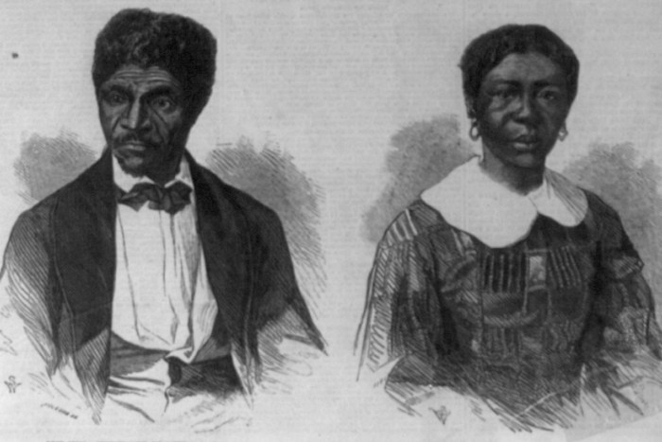
Dred Scott v. Sandford (1857)
Slavery in America – From the Constitution to the Civil War
Dred and Harriet Scott

Slide 35
Dred Scott v. Sandford (1857)
Slavery in America – From the Constitution to the Civil War
Harriet and Dred Scott and their daughters Eliza and Lizzie
Composite image created by students at Dickinson College, Prof. Matt Pinsker

Slide 36
Dred Scott v. Sandford (1857)
Dred and Harriet Scott were enslaved people brought by a slaveholder into an area where slavery was banned and then returned to an area where slavery was permitted. The Scotts sued for their freedom—arguing that their time on free soil made them free.
It took eleven years for the Scott’s lawsuit to get to the Supreme Court. The Supreme Court eventually rejected the Scott family’s claim.
Slavery in America – From the Constitution to the Civil War

Slide 37
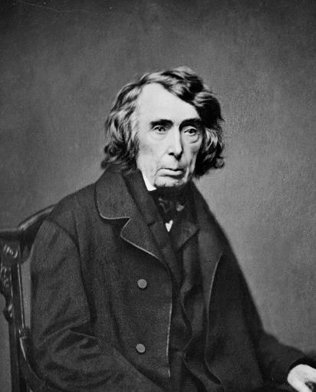
Dred Scott v. Sandford (1857)
Chief Justice Roger Taney wrote the opinion for the Supreme Court.
Taney based the Court’s decision, in part, on a historical claim: that at the Founding, African Americans were not citizens.
Slavery in America – From the Constitution to the Civil War
Chief Justice Roger Taney

Slide 38
Dred Scott v. Sandford (1857)
The Supreme Court then went out of its way to declare the Missouri Compromise unconstitutional, attacking Congress’s power to ban slavery in the territories—the core of the Republican Party’s political (and constitutional) platform.
Taney argued that the Missouri Compromise conflicted with the Fifth Amendment’s Due Process Clause—taking the property of slaveholders without due process of law.
Slavery in America – From the Constitution to the Civil War
Chief Justice Roger Taney

Slide 39
Dred Scott v. Sandford (1857)
“People of the United States” do not include African Americans, who (according to Taney) are considered a “subordinate and inferior class of beings, who had been subjugated by the dominant race, and, whether emancipated or not, yet remained subject to their authority, and had no rights or privileges but such as those who held the power the Government might choose to grant them.”
Slavery in America – From the Constitution to the Civil War
Chief Justice Roger Taney

Slide 40
Dred Scott v. Sandford (1857)
African Americans “had no rights that the white man was bound to respect”
Slavery in America – From the Constitution to the Civil War
Chief Justice Roger Taney

Slide 41
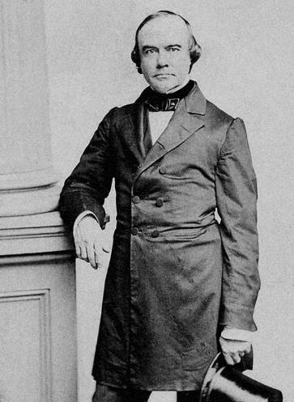
Dred Scott v. Sandford (1857)
Justice Benjamin Curtis and Justice John McLean dissented.
Justice Curtis’s Dred Scott dissent used history to show that many state constitutions did allow for voting by free African Americans at the time of ratification.
By his count, five states permitted African American voting at the time that the Founding generation ratified the Constitution.
Slavery in America – From the Constitution to the Civil War
Justice Benjamin Curtis

Slide 42
Dred Scott v. Sandford (1857)
“I can find nothing in the Constitution which . . . deprives of their citizenship any class of persons who were citizens of the United States at the time of its adoption, or who should be native-born citizens of any State after its adoption; nor any power enabling Congress to disenfranchise persons born on the soil of any State, and entitled to citizenship of such state by its Constitution and laws. And my opinion is, that, under the Constitution of the United States, every free person born on the soil of a state, who is a citizen of that State by force of its Constitution or laws, is also a citizen of the United States.”
Slavery in America – From the Constitution to the Civil War
Justice Curtis, dissenting

Slide 43
Dred Scott v. Sandford (1857)
Changes in New York and New Jersey limiting or ending African American suffrage could “have no other effect upon the present inquiry except to show that, before they were made, no such restrictions existed, and [African American], in common with white, persons, were not only citizens of those States, but entitled to the elective franchise on the same qualifications as white persons, as they now are in New Hampshire and Massachusetts.”
Slavery in America – From the Constitution to the Civil War
Justice Curtis, dissenting

Slide 44
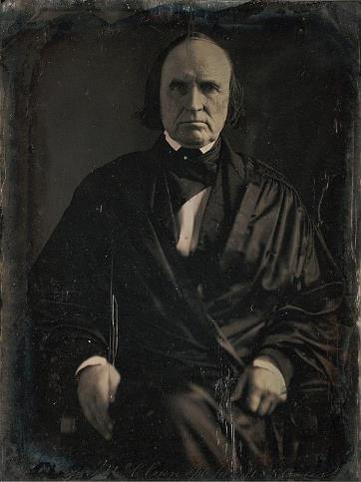
Dred Scott v. Sandford (1857)
“Our independence was a great epoch in the history of freedom, and while I admit the Government was not made especially for [African Americans], yet many of them were citizens of the New England States, and exercised, the rights of suffrage when the Constitution was adopted, and it was not doubted by any intelligent person that its tendencies would greatly ameliorate their condition.”
Slavery in America – From the Constitution to the Civil War
Justice McLean, dissenting

Slide 45
Dred Scott v. Sandford (1857)
In 1857, “[s]everal of the States have admitted persons of color to the right of suffrage, and, in this view, have recognized them as citizens, and this has been done in the slave as well as the free States.”
Slavery in America – From the Constitution to the Civil War
Justice McLean, dissenting

Slide 46
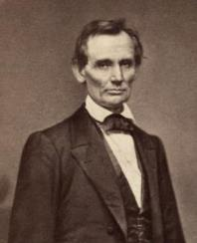
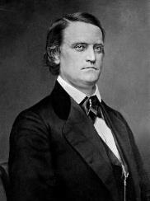
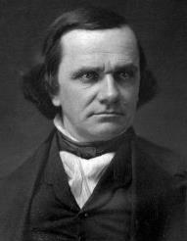
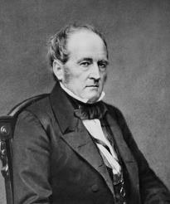
The Election of 1860
Slavery in America – From the Constitution to the Civil War
Abraham Lincoln
John C. Breckinridge
Stephen A. Douglas
John Bell
Abraham was the Republican candidate. The Democratic Party split between its Southern and Northern wings—represented by John C. Breckinridge and Stephen A. Douglas, respectively. And John Bell ran as the Constitutional Union candidate.

Slide 47
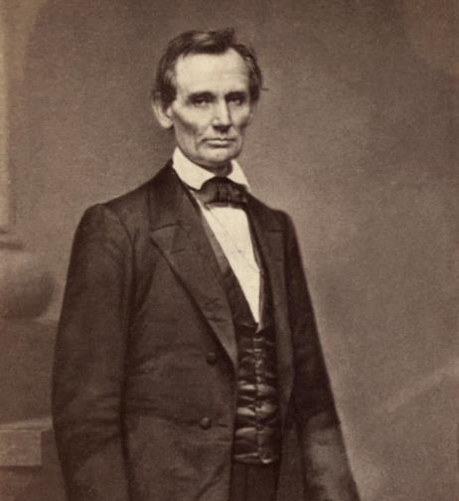
The Election of 1860
Republican Abraham Lincoln won the election with a plurality of the vote.
Lincoln became the nation’s first anti-slavery President, leading to a wave of secessions by slaveholding states in the South.
Slavery in America – From the Constitution to the Civil War
Abraham Lincoln

Slide 48
THE CIVIL WAR
Following Lincoln’s election, South Carolina voted unanimously to secede from the Union in December 1860 and was quickly joined by six other Southern states, forming their own confederacy
Attempts to avoid armed conflict failed. On April 12, 1861, Confederate forces fired on Fort Sumter. Lincoln called 75,000 state militiamen into federal service, and four more states joined the Confederacy—The Civil War had begun.
At first, many Northerners believed that they were fighting to preserve the Union, while white Southerners believed that a break from the Union was justified to maintain slavery and protect sectional interests. Radical voices in the North called for more aggressive action against slavery.
Slavery in America – From the Constitution to the Civil War

Slide 49
THE CIVIL WAR
As the war dragged on, President Lincoln and Congress—pushed by African American refugees, abolitionists, and radical voices in Congress—would begin to move more decisively against slavery.
Over time, the Union remained the war’s main aim, but the war increasingly became one of liberation. For instance, as hopes for a short war diminished, President Lincoln and congressional Republicans pursued an aggressive anti-slavery program:
Ending slavery in Washington, D.C. (in May 1862).
Banning it in the territories.
And passing laws that permitted the military to emancipate enslaved people who came into Union lines.
Slavery in America – From the Constitution to the Civil War

Slide 50
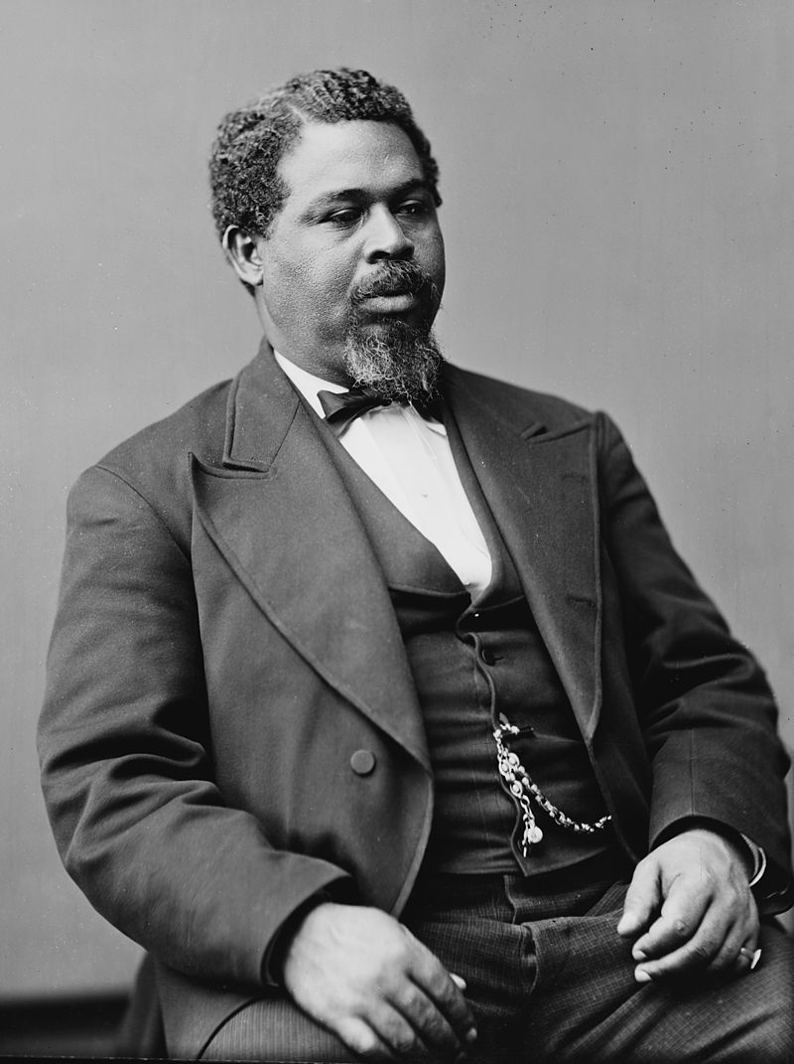
Robert Smalls
Slavery in America – From the Constitution to the Civil War

Slide 51
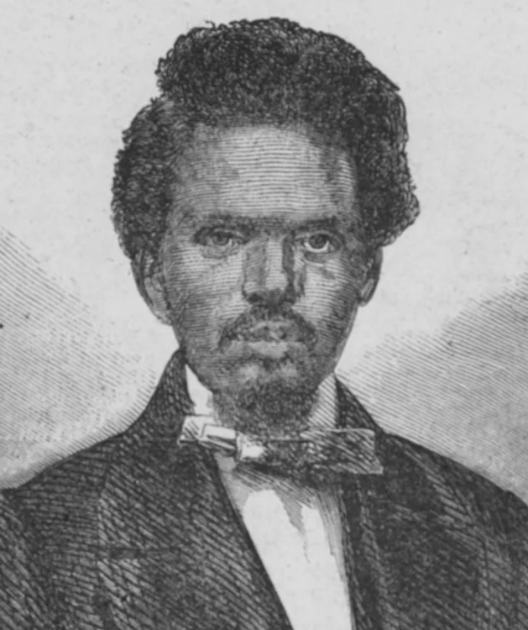
Who Was Robert Smalls?
Robert Smalls was born an enslaved person in Beaufort, South Carolina, in 1839.
A little over twenty years later, he had won freedom for his entire family and was celebrated as a Civil War hero.
Later, he emerged as a community leader in Beaufort during Reconstruction
Slavery in America – From the Constitution to the Civil War
Robert Smalls

Slide 52
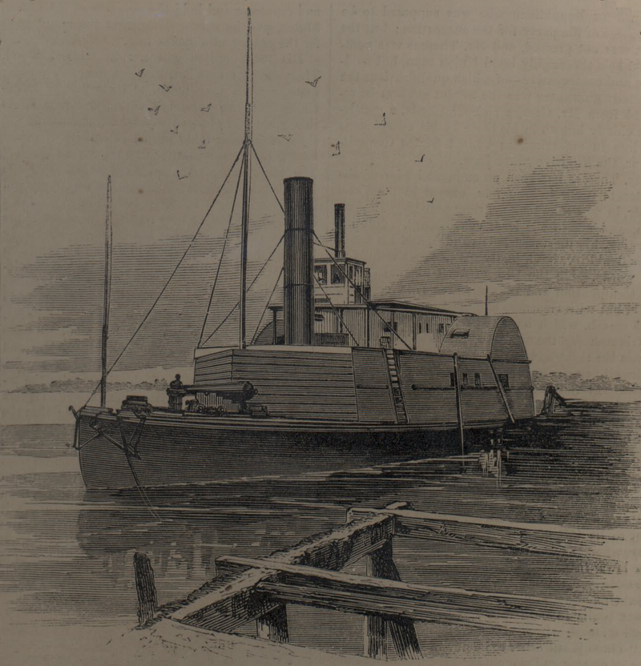
Robert Smalls
During the Civil War, Smalls first served as an enslaved crew member (as a pilot) on a Confederate ship called The Planter. From that position, Smalls devised a plan to free his entire family and others from enslavement.
Slavery in America – From the Constitution to the Civil War
CSS The Planter

Slide 53
Robert Smalls
In May, 1862 The Planter’s white crew members left Smalls and his fellow enslaved crew members to stay with the boat, they sailed the ship to a wharf to pick up their family members.
These 16 enslaved people then sailed past Confederate forces. Because of his experience as a pilot, Smalls knew the proper signals to give to the Confederates at two check points—he even wore his captain’s hat and mimicked his mannerisms to help disguise his identity.
Once Smalls had sailed his ship outside of Confederate waters, the crew raised a white flag, and after arriving at the Union blockade, Smalls then turned his ship over to the U.S. Navy.
Smalls would go on to serve as a pilot in the U.S. Navy (he was even injured in battle) and would recruit 5,000 African American soldiers to the Union cause.
Slavery in America – From the Constitution to the Civil War

Slide 54

Robert Smalls
Slavery in America – From the Constitution to the Civil War
Smalls used the prize money that he had received from Congress for capturing The Planter to purchase the mansion of his former enslaver, Henry McKee.

Slide 55
Robert Smalls
In 1864, Smalls served as a delegate to the Republican National Convention that nominated Abraham Lincoln for a second term.
In 1868, he served as a delegate to the South Carolina state convention, which rewrote the state constitution.
That same year, he was also elected to the state House of Representatives.
In 1872, he was elected to the state Senate.
In 1874, he was elected to serve in the U.S. House of Representatives—serving five terms, from 1875 to 1887.
Slavery in America – From the Constitution to the Civil War
Robert Smalls

Slide 56
Robert Smalls
“My race needs no special defense for the past history of them and this country. It proves them to be equal of any people anywhere. All they need is an equal chance in the battle of life.”
Slavery in America – From the Constitution to the Civil War
Robert Smalls

Slide 57
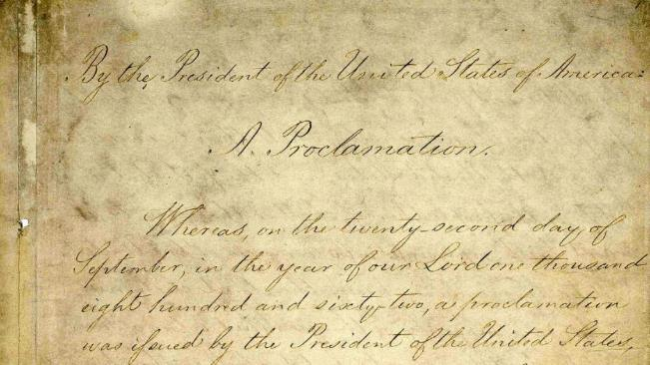
Emancipation Proclamation
Slavery in America – From the Constitution to the Civil War
With the Emancipation Proclamation on January 1, 1963, President Lincoln relied on his war powers to free all enslaved people held within the Confederacy.

Slide 58
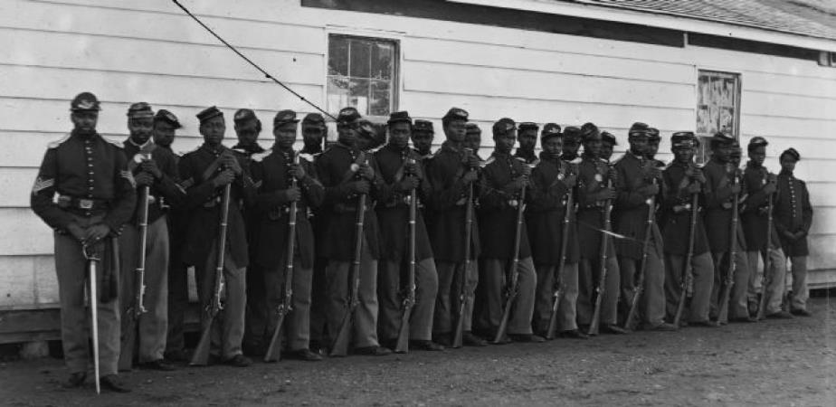
African American Soldiers
Slavery in America – From the Constitution to the Civil War
Company I of the 36th Colored Regiment
U.S. Colored Troops, (USCT) Infantry

Slide 59
THE CIVIL WAR
Over time, thousands of African Americans signed up for the Union Army—with hundreds of thousands of African Americans fighting the Confederacy—and laying claim to the promise of equal citizenship.
And African Americans in Convention—before, during, and after the Civil War—demanded their rights, petitioning Congress for equal rights, key liberties (like free speech, religious liberty, and the right to keep and bear arms), and for the right to vote.
Of course, following a bloody Civil War, President Lincoln and the Union prevailed. The debate quickly turned to the question of what comes next—Reconstruction.
Slavery in America – From the Constitution to the Civil War

Slide 60
Reconstruction and the
“Second Founding”
Following the Civil War, our nation confronted a series of vexing questions.
What was the meaning of the Civil War—a bloody, bloody war—and what should be the terms of a lasting peace?
How should our nation answer the Declaration of Independence’s prophetic call for freedom and equality?
How should we define what it means to be a U.S. citizen?
How broadly should the right to vote sweep?
And what role—if any—should the federal government play in protecting the civil and political rights of all?
Slavery in America – From the Constitution to the Civil War

Slide 61
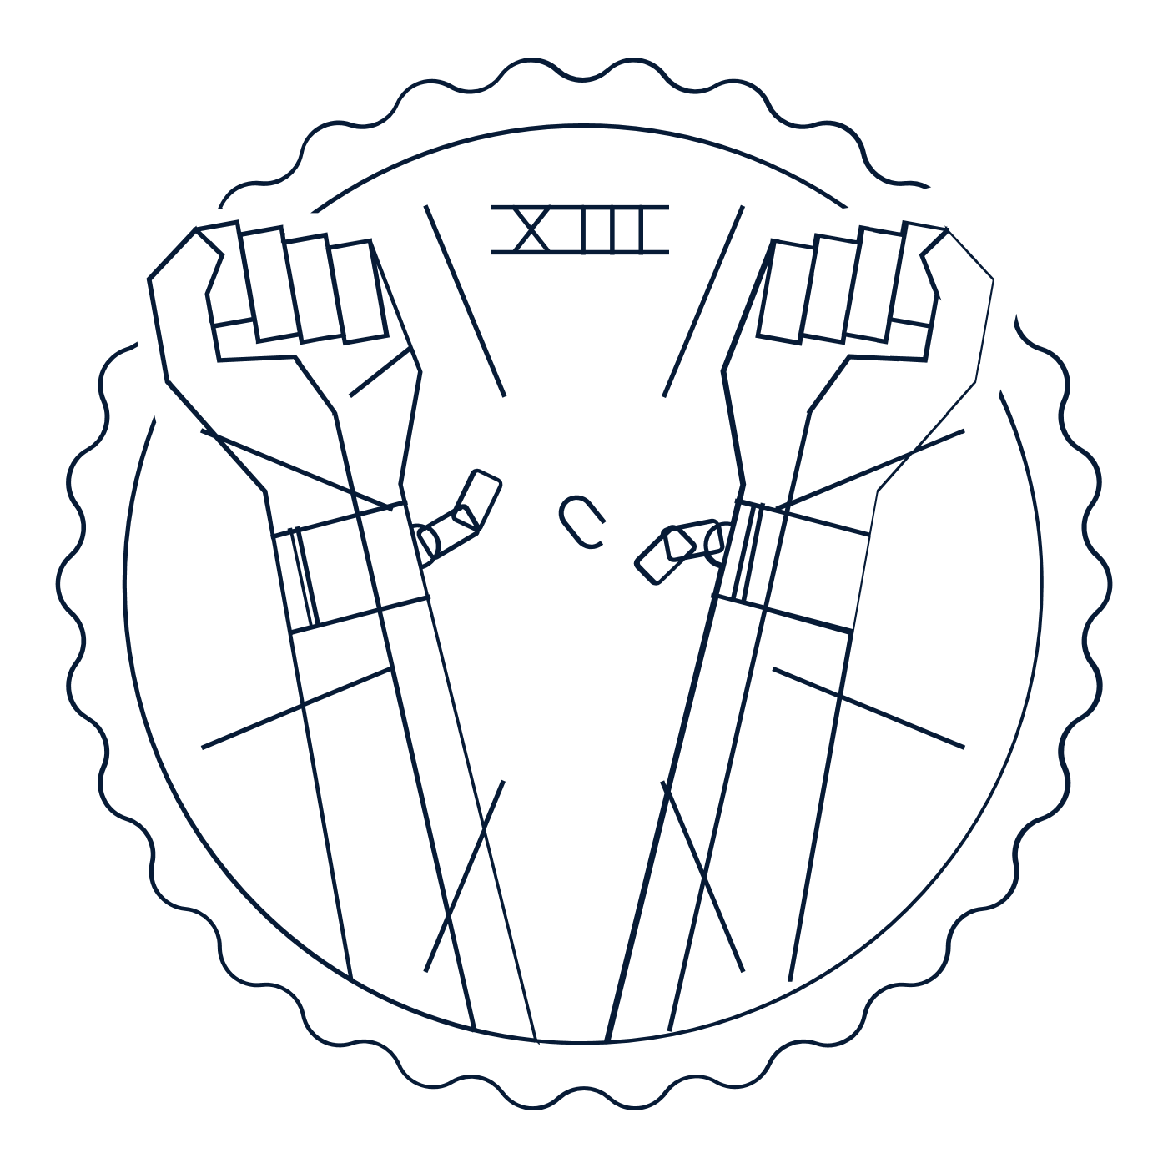


The Reconstruction Amendments
13th Amendment
14th Amendment
15th Amendment
Slavery in America – From the Constitution to the Civil War
1865
Abolished slavery
1868
Wrote promises of freedom and equality into the Constitution
1870
Banned racial discrimination in voting

Slide 62
Reconstruction and the
“Second Founding”
After our nation’s Second Founding:
Our Constitution abolished slavery. (That’s the 13th Amendment)
It made everyone born on American soil a U.S. citizen. (That’s the 14th Amendment.)
It promised equality for all. (That’s the 14th Amendment—again!)
It protected us from state abuses of important rights like free speech. (That’s the 14th Amendment—yet again!)
It guaranteed the right to vote free of racial discrimination. (That’s the 15th Amendment.)
And it gave the national government the authority to protect the civil and political rights of all. (That’s the 13th, 14th, and 15th Amendments!)
Slavery in America – From the Constitution to the Civil War

Slide 63
The 13th Amendment
Section 1
Neither slavery nor involuntary servitude, except as a punishment for crime whereof the party shall have been duly convicted, shall exist within the United States, or any place subject to their jurisdiction.
Section 2
Congress shall have power to enforce this article by appropriate legislation.
Slavery in America – From the Constitution to the Civil War

Slide 64
The 14th Amendment
Section 1
All persons born or naturalized in the United States, and subject to the jurisdiction thereof, are citizens of the United States and of the State wherein they reside. No State shall make or enforce any law which shall abridge the privileges or immunities of citizens of the United States; nor shall any State deprive any person of life, liberty, or property, without due process of law; nor deny to any person within its jurisdiction the equal protection of the laws.
Section 5
The Congress shall have the power to enforce, by appropriate legislation, the provisions of this article.
Slavery in America – From the Constitution to the Civil War

Slide 65
The 14th Amendment
Four ways in which the 14th Amendment transformed the Constitution forever:
Birthright Citizenship
Equality
Freedom
National Power Over Civil Rights
Slavery in America – From the Constitution to the Civil War

Slide 66

THE 15TH AMENDMENT
Section 1
The right of citizens of the United States to vote shall not be denied or abridged by the United States or by any State on account of race, color, or previous condition of servitude.
Section 2
The Congress shall have the power to enforce this article by appropriate legislation.
Passed by Congress February 26, 1869. Ratified February 3, 1870

Slide 67
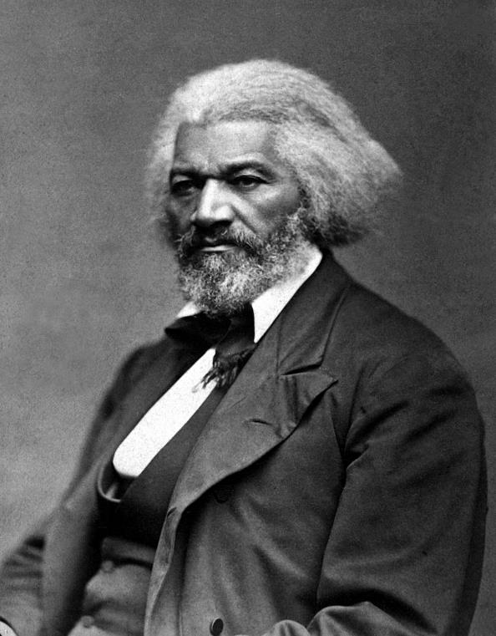
THE 15TH AMENDMENT
“The revolution wrought in our condition by the 15th Amendment . . . is almost startling, even to me. I view it with something like amazement.”
FREDERICK DOUGLASS

Slide 68
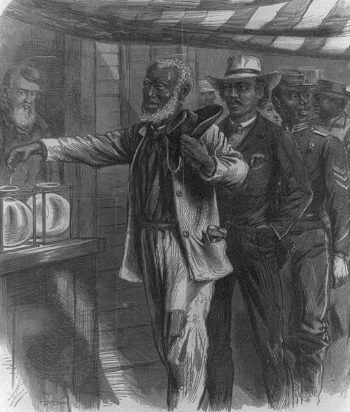
NEW BIRTH OF FREEDOM
We saw African Americans voting in massive numbers and holding office at all levels of government.
As U.S. Senators and U.S. House Members.
As Governors and state legislators.
All the way down to key positions in local governments throughout the South
“THE FIRST VOTE"
A.R. WAUD, WOOD ENGRAVING, 1867
LOC PRINTS & PHOTOGRAPHS DIVISION

Slide 69
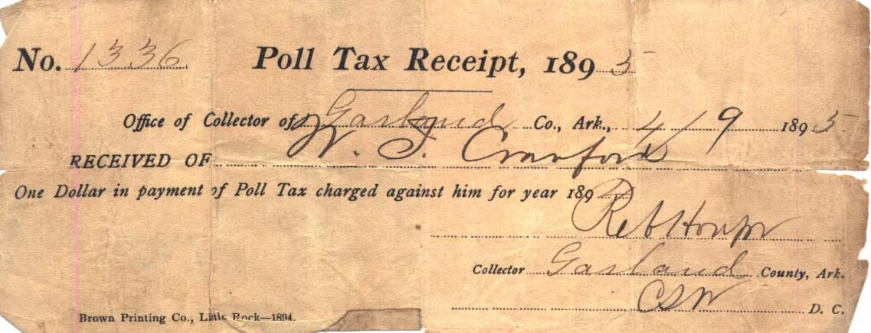
SUPPRESSING THE VOTE
“The most significant fact about the 15th Amendment in American history is that it was essentially ignored and circumvented for nearly a century.”
Rick Pildes and Brad Smith for the Interactive Constitution

Slide 70
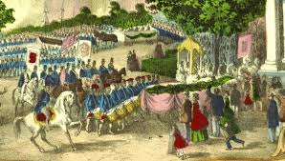
Reconstruction and the
“Second Founding”
Slavery in America – From the Constitution to the Civil War

Slide 71
Reconstruction and the
“Second Founding”
Big Idea
It’s only after Lincoln, emancipation, victory in the Civil War, and the ratification of the Reconstruction Amendments that the Constitution begins to fully emerge as the inspiring document that it is today, redeeming us from the Framers’ original sin of slavery and beginning to give our nation what Lincoln promised at Gettysburg—“a new birth of freedom.”
Slavery in America – From the Constitution to the Civil War

Slide 72
Reconstruction and the
“Second Founding”
Big Idea
While the original Constitution—plus the Bill of Rights—remains a powerful statement of many of America’s most enduring principles, the Thirteenth, Fourteenth, and Fifteenth Amendments truly represent our nation’s “Second Founding.”
Slavery in America – From the Constitution to the Civil War

Slide 73
Reconstruction and the
“Second Founding”
Big Idea
While America has struggled to realize the promise of our nation’s Second Founding, these transformational amendments represent some of our Constitution’s most important principles—and protections.
Slavery in America – From the Constitution to the Civil War

