Slide 1
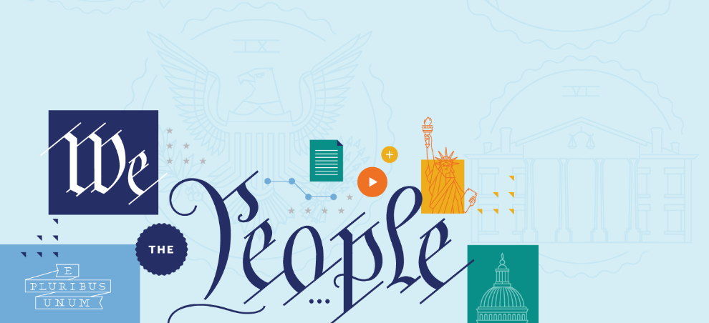
FIRST AMENDMENT: RELIGION CLAUSES
First Amendment: Religion Clauses

Slide 2
BIG QUESTIONS
Why did the Founding generation write protections for religious liberty into the First Amendment?
What is the Establishment Clause? What was the Founders’ vision for this provision of the First Amendment? And how has the Supreme Court interpreted it over time?

Slide 3
BIG QUESTIONS
What is the Free Exercise Clause? What was the Founders’ vision for this provision of the First Amendment? And how has the Supreme Court interpreted it over time?
What are some of the most important areas of constitutional debate over religious liberty today?

Slide 4
THE FIRST AMENDMENT
“Congress shall make no law respecting an establishment of religion, or prohibiting the free exercise thereof; or abridging the freedom of speech, or of the press; or the right of the people peaceably to assemble, and to petition the Government for a redress of grievances.”

Slide 5
THE FIRST AMENDMENT
SPEECH AND PRESS
RELIGION
ASSEMBLY AND PETITION
ESTABLISHMENT CLAUSE
FREE EXERCISE CLAUSE

Slide 6
THE ESTABLISHMENT CLAUSE
“Congress shall make no law respecting an establishment of religion, or prohibiting the free exercise thereof;
The Establishment Clause prohibits the government from establishing or creating a religion in any way—that’s why we don’t have an official religion in the United States.

Slide 7
THE FREE EXERCISE CLAUSE
“Congress shall make no law respecting an establishment of religion, or prohibiting the free exercise thereof;
The Free Exercise Clause gives us all the right to worship God, or not, as we choose. That means the government can’t punish you because of your religious beliefs, or because you don’t belong to a church, or believe in God.

Slide 8
BIG IDEA
The First Amendment protects religious liberty in two ways. First, it guards against government establishment of religion. And second, it protects the free exercise of religion. Together, these constitutional promises are at the core of our freedom of conscience—the right to freely believe as we wish.

Slide 9
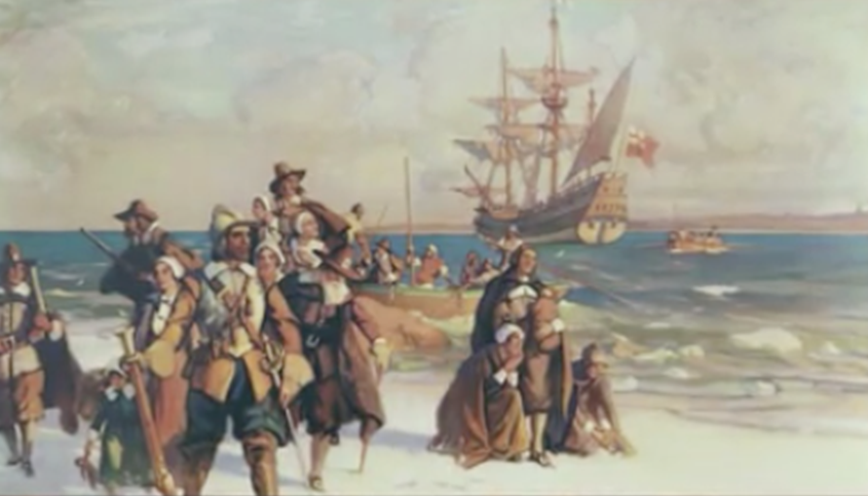
RELIGION IN THE COLONIES

Slide 10
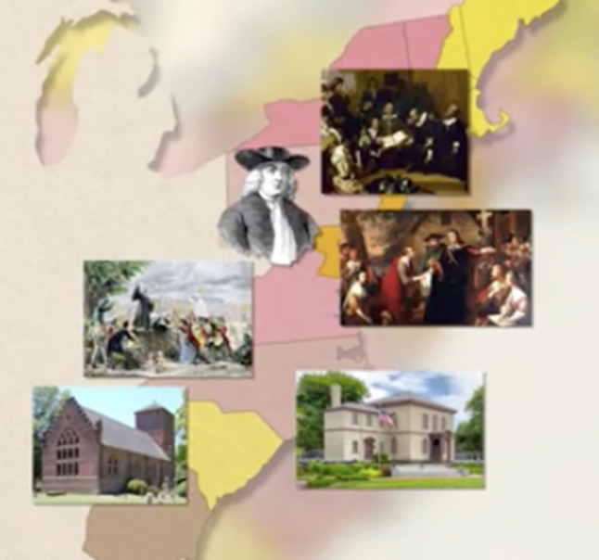
RELIGION IN THE COLONIES
Puritans in New England
Anglicans in the South
Quakers and Lutherans in Pennsylvania
Roman Catholics in Maryland
Presbyterians throughout the middle colonies.
And Jewish congregations from Rhode Island to Georgia

Slide 11
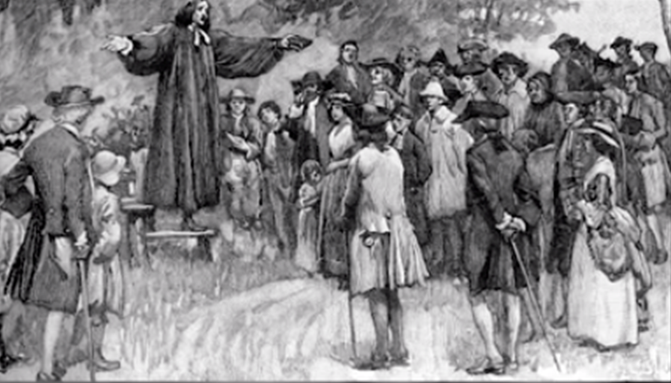
RELIGION IN THE COLONIES

Slide 12
RELIGION IN THE STATES
Following Independence, there was a general consensus that the national government shouldn’t be able to establish a national church, and the Establishment Clause, authored by James Madison, reflected this consensus.
The language of the Clause itself applied only to the national government—calling out Congress. So, the national government couldn’t establish a national church, but states still could. Even so, by 1833, all states had disestablished their state churches.

Slide 13
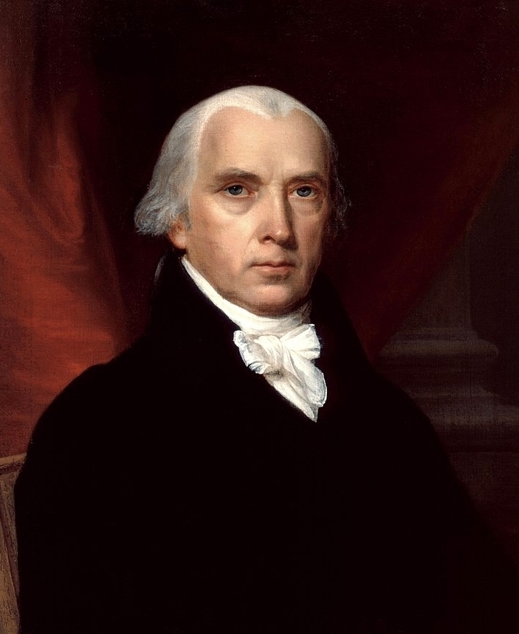
“It is the duty of every man to render to the Creator such homage, and such only, as he believes to be acceptable to him. This duty is precedent both in order of time and degree of obligation, to the claims of Civil Society.”
James Madison

Slide 14
ARTICLE VI OF THE CONSTITUTION (1787)
“…no religious Test shall ever be required as a Qualification to any Office or public Trust under the United States.”

Slide 15
FIRST AMENDMENT ESTABLISHMENT CLAUSE
“CONGRESS SHALL MAKE NO LAW RESPECTING AN ESTABLISHMENT OF RELIGION…

Slide 16
ESTABLISHMENT CLAUSE TODAY
Virtually all jurists would agree that it would violate the Establishment Clause for the government to:
Require church attendance
Mess with a religious organization’s selection of clergy, or its religious doctrine
Grant benefits to some religious entities, but not others, without some legitimate non-religious justification

Slide 17
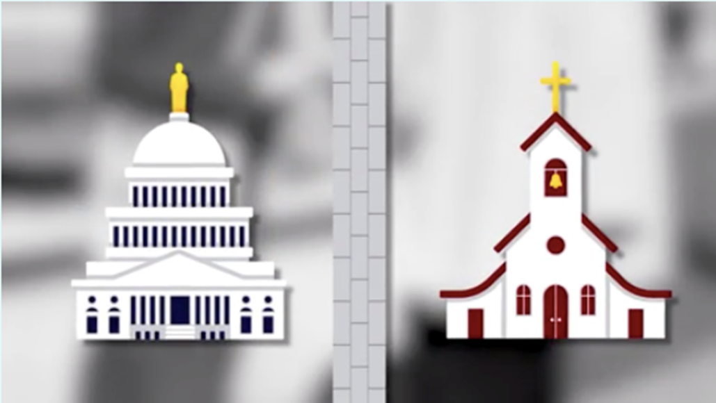

Slide 19
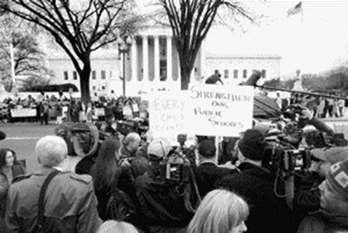
LEMON V. KURTZMAN (1971)

Slide 20
THE LEMON TEST LEMON V. KURTZMAN (1971)
The statute must have a secular legislative purpose
Its principal or primary effect must be one that neither advances nor inhibits religion
The statute must not foster an excessive entanglement with religion

Slide 21
TYPES OF ESTABLISHMENT CLAUSE CASES
Government Funding
Government Sponsored Prayer
Religious Symbols on Government Property

Slide 22
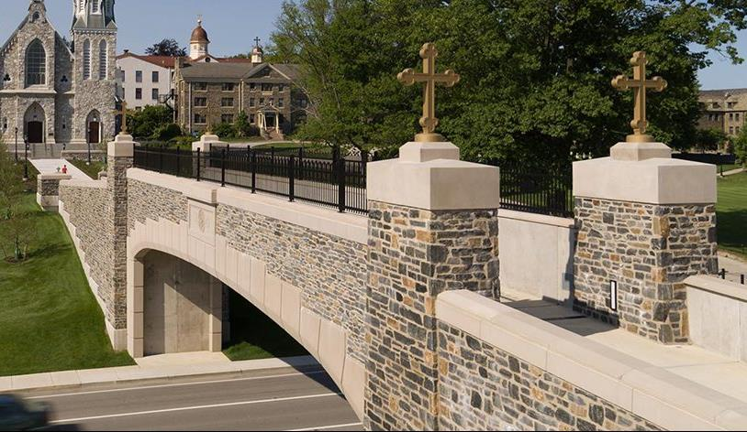
AID TO RELIGIOUS EDUCATION OR OTHER ACTIVITIES CONDUCTED BY RELIGIOUS INSTITUTIONS

Slide 23
AID TO RELIGIOUS EDUCATION OR OTHER ACTIVITIES CONDUCTED BY RELIGIOUS INSTITUTIONS
Court first upheld state laws allowing students who attend private religious schools to receive transportation (Everson v. Board of Education, 1947).

Slide 24
AID TO RELIGIOUS EDUCATION OR OTHER ACTIVITIES CONDUCTED BY RELIGIOUS INSTITUTIONS
More recently, the Court has
Upheld programs that give government money to educational or social programs on a neutral basis—“only as a result of the genuine and independent choices of private individuals” (Zelman v. Simmons-Harris, 2002)
Struck down state laws that keep religious institutions that otherwise qualify for government aid/assistance solely from getting it (Trinity Lutheran Church of Columbia v. Comer, 2017).

Slide 25
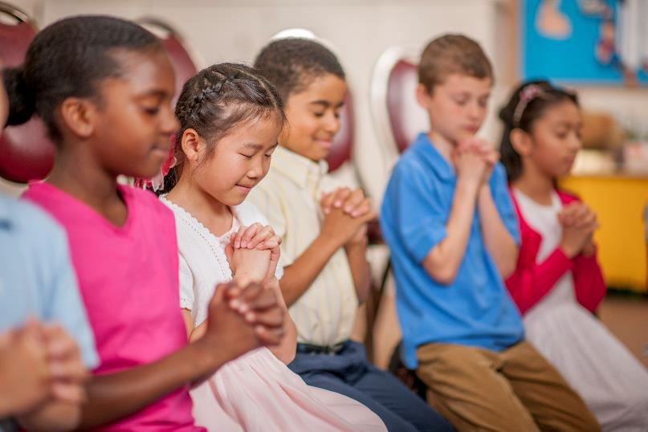
GOVERNMENT-SPONSORED PRAYER

Slide 26
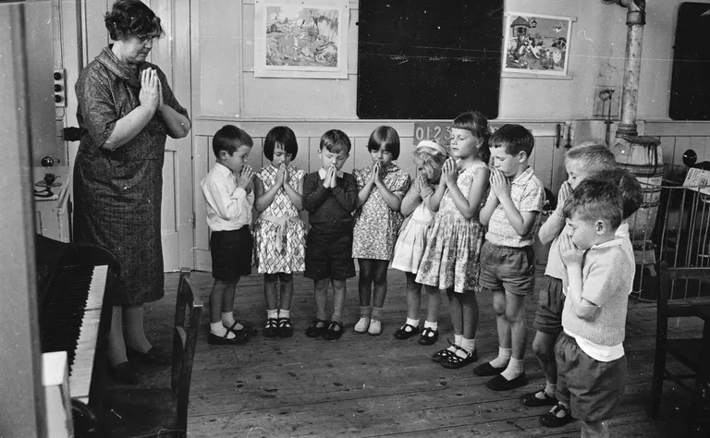
GOVERNMENT-SPONSORED PRAYER
It is unconstitutional for public schools to lead schoolchildren in prayer or Bible reading, even on a voluntary basis
Engel v. Vitale, 1962
Abington School District v. Schempp, 1963

Slide 27
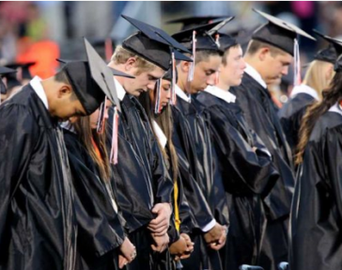
GOVERNMENT-SPONSORED PRAYER
The Court has even gone so far as to extend the prayer ban to:
Graduation Ceremonies (Lee v. Weisman, 1992)
Football Games (Santa Fe Independent School District v. Doe, 2000)

Slide 28
GOVERNMENT-SPONSORED PRAYER
However, in settings involving adults, the Court has generally allowed government-sponsored prayer,
Upholding legislative prayer (Marsh v. Chambers, 1983)
Approving an opening prayer or statement at town council meetings, where the town represented that it would accept prayers from all faiths (Town of Greece v. Galloway, 2014).

Slide 29
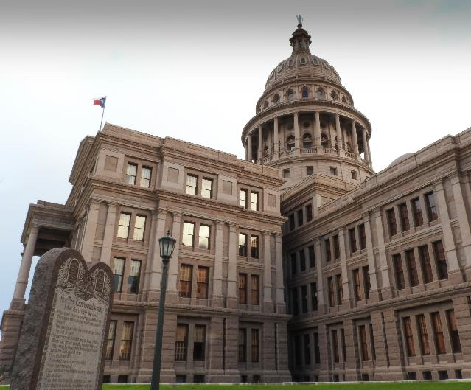
GOVERNMENT-OWNED OR -SPONSORED RELIGIOUS SYMBOLS

Slide 30
ENDORSEMENT TEST
Asks the common-sense question of whether a reasonable observer acquainted with the full context would regard the display as the government endorsing religion and, therefore, sending a message of discouragement to other believers and non-believers.

Slide 31
GOVERNMENT-OWNED OR -SPONSORED RELIGIOUS SYMBOLS
Lynch v. Donnelly (1984), the Court upheld the display of a nativity scene surrounded by other holiday decorations in the heart of a shopping district.
But in County of Allegheny v. ACLU (1989), a different set of Justices held that the display of a nativity scene by itself at the top of the grand stairway in a courthouse violated the Establishment Clause.

Slide 32
GOVERNMENT-OWNED OR -SPONSORED RELIGIOUS SYMBOLS
In McCreary County v. ACLU (2005), the Court held that a prominent display of the Ten Commandments at the county courthouse, which was preceded by an official’s description of the Ten Commandments as the “embodiment of ethics in Christ,” was unconstitutional
While on the same day—in Van Orden v. Perry (2005)— upholding a Ten Commandments monument, which was donated by a secular organization dedicated to reducing juvenile delinquency and surrounded by other monuments on the spacious state grounds.

Slide 33
FIRST AMENDMENT FREE EXERCISE CLAUSE
“CONGRESS SHALL MAKE NO LAW respecting an establishment of religion, or
PROHIBITING THE FREE EXERCISE THEREOF…

Slide 34
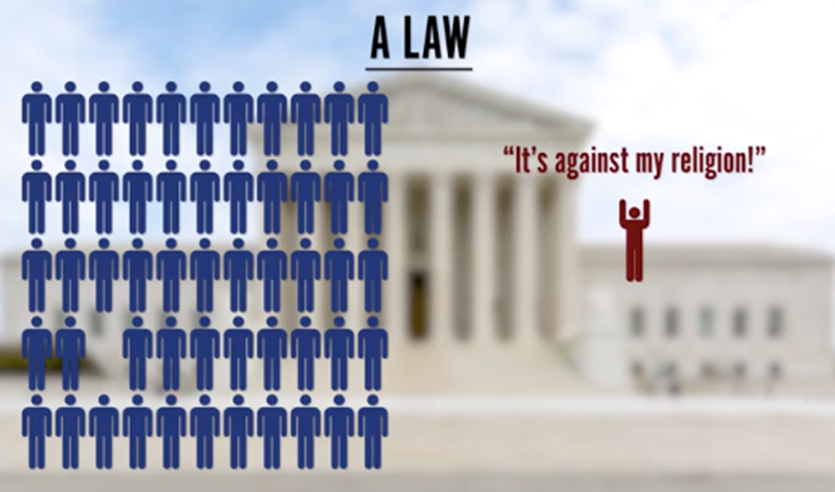

Slide 35
FREE EXERCISE CLAUSE
The court has said that the free exercise clause “embraces two concepts—freedom to believe and the freedom to act. The first is absolute but, in the nature of things, the second cannot be.” (Cantwell v. Connecticut, 1940).

Slide 36
FREE EXERCISE IN LEGAL CHALLENGES
When the government bans behavior that a person’s religion requires (Polygamy, animal sacrifice, the use of hallucinogenic drugs, or even human sacrifice, for that matter)
When the government requires conduct that a person’s religion bans (Fighting in a war, paying taxes to serve a program that violates your religious beliefs, or taking off your yarmulke)
When individuals claim that laws burden religious observance (Working on the Sabbath)

Slide 37
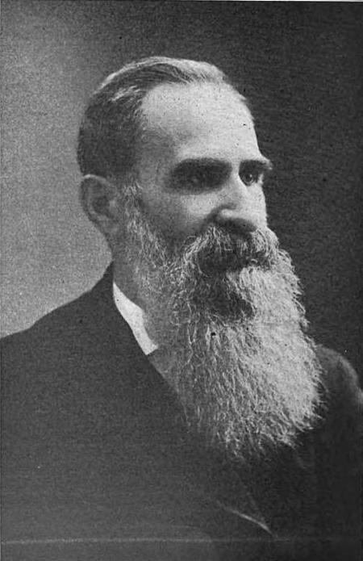
REYNOLDS V. UNITED STATES (1878)
The Court unanimously rejected free exercise challenges to anti-polygamy laws aimed at suppressing the practice by members of LDS church, holding that the Free Exercise Clause protects beliefs but not conduct.
George Reynolds

Slide 38
REYNOLDS V. UNITED STATES (1878)
“Laws are made for the government of actions, and while they cannot interfere with mere religious belief and opinions, they may with practices.”
George Reynolds

Slide 39
REYNOLDS V. UNITED STATES (1878)
To rule otherwise “would be to make the professed doctrines of religious belief superior to the law of the land, and in effect to permit every citizen to become a law unto himself.”
George Reynolds

Slide 40
FREE EXERCISE CLAUSE IN THE TWENTIETH CENTURY.
In Cantwell v. Connecticut, 1940, the Court finally extended the Clause to limit state laws and other state actions that burden religious exercise (incorporation).
In the 60s and early 70s, the Court shifted, strengthening protection for religious conduct by reading the Free Exercise Clause to protect a right of religious believers to exemption from generally applicable laws which burden religious exercise.

Slide 41
SHERBERT V. VERNER (1963)
A state denied unemployment benefits to a woman, a member of the Seventh-Day Adventist Church, who quit her job rather than work on her Saturday Sabbath.
Adeil Sherbert

Slide 42
SHERBERT V. VERNER (1963)
The Supreme Court concluded that making her choose between her faith and her income, and the denial of benefits, imposed a substantial burden and constituted a violation of the Free Exercise Clause.
Adeil Sherbert

Slide 43
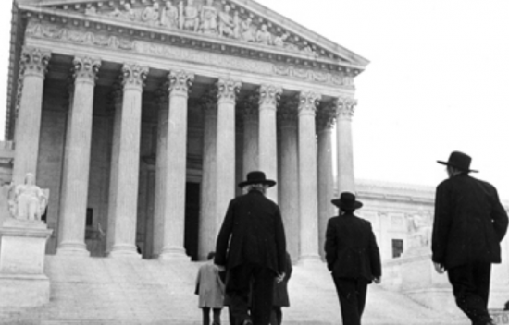
WISCONSIN V. YODER (1972)

Slide 44
WISCONSIN V. YODER (1972)
The Court reasoned: “The Amish objection to formal education beyond the eighth grade is firmly grounded in [their] religious concepts. They object to high school, and higher education generally, because the values they teach are in marked variance with Amish values and the Amish way of life; they view secondary school education as an impermissible exposure of their children to a ‘worldly’ influence in conflict with their beliefs.”

Slide 45
WISCONSIN V. YODER (1972)
“The record in this case abundantly supports the claim that the traditional way of life of the Amish is not merely a matter of personal preference, but one of deep religious conviction, shared by an organized group, and intimately related to daily living.”

Slide 46
WISCONSIN V. YODER (1972)
The Court concluded: “The impact of the compulsory-attendance law on respondents’ practice of the Amish religion is not only severe, but inescapable, for the Wisconsin law affirmatively compels them, under threat of criminal sanction, to perform acts undeniably at odds with . . . their religious belief.”

Slide 47
WISCONSIN V. YODER (1972)
And the “self-sufficient” nature of Amish society made education for 14- and 15-year-old children unnecessary and the two additional years of compulsory education “will not impair the physical or mental health of the child, or result in an inability to be self-supporting or to discharge the duties and responsibilities of citizenship, or in any other way materially detract from the welfare of society.”

Slide 48
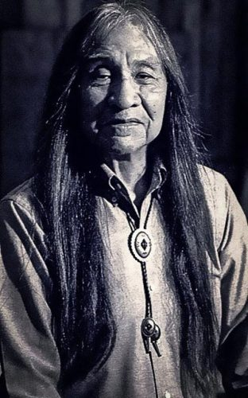
EMPLOYMENT DIVISION V. SMITH (1990)
The case involved Native Americans dismissed from their jobs for failing a drug test.
They had smoked peyote during a religious ceremony. Because of this drug use—religiously motivated or not—Oregon then denied them unemployment benefits.
Alfred Leo Smith

Slide 49
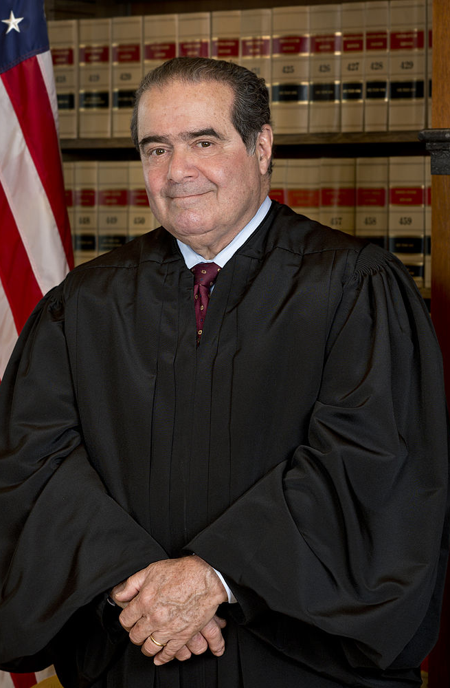
EMPLOYMENT DIVISION V. SMITH (1990)
When they challenged this action on free exercise grounds, the Supreme Court rejected their claim.
Justice Scalia—writing for the majority—traded the traditional test for a clearer rule that was even less protective of religious objectors.
Justice Antonin Scalia

Slide 50
EMPLOYMENT DIVISION V. SMITH (1990)
Justice Scalia wrote that the Free Exercise Clause “does not relieve an individual of the obligation to comply with a valid and neutral law of general applicability on the ground that the law proscribes (or prescribes) conduct that his religion prescribes (or proscribes).”

Slide 51
EMPLOYMENT DIVISION V. SMITH (1990)
Scalia echoed Reynolds’s concern that religious exemptions permit a person, “by virtue of his beliefs, to become a law unto himself,” contradicting “both constitutional tradition and common sense.”
Any religious exceptions to general laws, therefore, must come from the “political process.”

Slide 52
CONGRESSIONAL LEGISLATION
Religious Freedom Restoration Act (1993)
Religious Land Use and Institutionalized Persons Act
Allow courts to exempt a person from any law that imposes a substantial burden on sincere religious beliefs or actions, unless the government can show that the law is the “least restrictive means” of furthering a “compelling governmental interest.”.

Slide 53
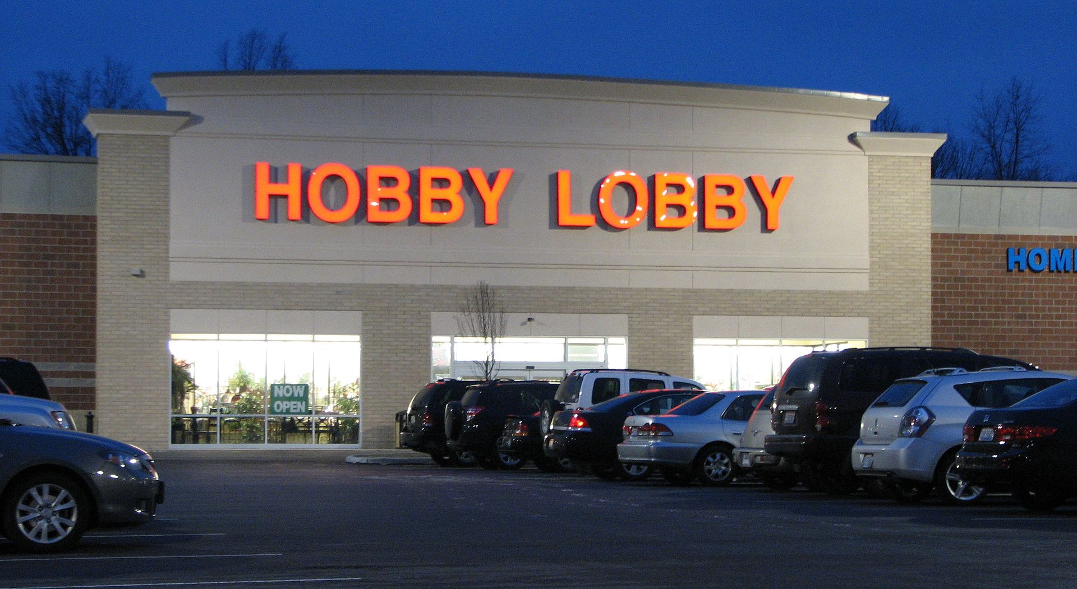
BURWELL V. HOBBY LOBBY STORES INC (2014)
The Court by a 5-4 vote excused a commercial family-owned corporation from complying with the Affordable Care Act’s “contraception mandate.”

Slide 54
CHURCH OF THE LUKUMI BABALU AYE, INC. V. CITY OF HIALEAH (1993)
The Court unanimously struck down a local law against the “unnecessary” killing of animals in a “ritual or ceremony” because the law was directed against the Santeria religion, which uses animal sacrifice as one of its principal forms of worship.
The Court said that Smith was still good law, but that Smith’s (easy-to-pass) test didn’t apply in a case like this one—when a law was drawn to apply only to a small and unpopular religious sect. So, with Lukumi, the Court wrote a strong anti-discrimination principle into Free Exercise law.

Slide 55
ESPINOZA V. MONTANA DEPARTMENT OF REVENUE (2020)
The Court struck down Montana’s “no aid” provision, which prevented religious schools and religious parents from receiving public benefits because of the religious nature of the school. The Court ruled that this was a violation of the Free Exercise Clause.

Slide 56
ESPINOZA V. MONTANA DEPARTMENT OF REVENUE (2020)
The Free Exercise Clause “protects religious observers against unequal treatment” and against “laws that impose special disabilities on the basis of religious status.” Status-based discrimination—punishing the free exercise of religion by disqualifying the religious from government aid—gets the strictest of scrutiny from the Court. The Court concluded that while states need not give money to private education, once they do, they cannot discriminate solely on the basis of religious belief.

Slide 57
