Slide 1
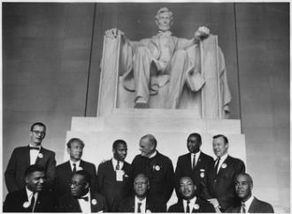
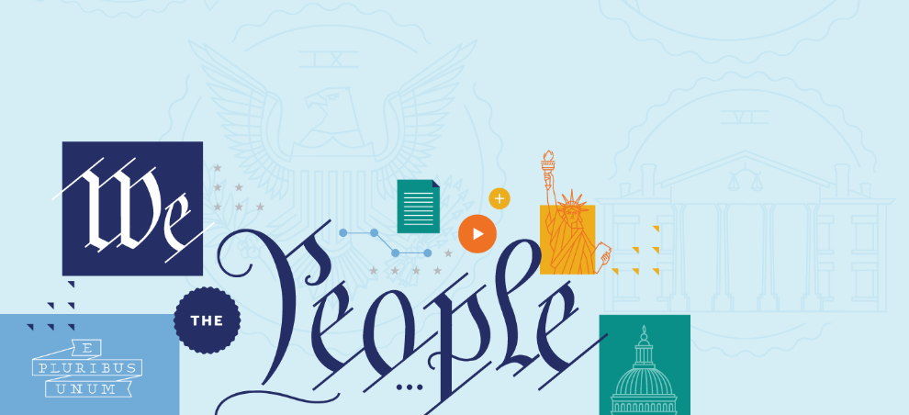
THE CIVIL RIGHTS MOVEMENT, THE WARREN COURT, AND LANDMARK CIVIL RIGHTS LAWS
Scholar Exchange:
The Civil Rights Movement, the Warren Court, and Landmark Civil Rights Laws
The Civil Rights Movement, the Warren Court, and Landmark Civil Rights Laws

Slide 2
BIG QUESTIONS
What was the Civil Rights Movement? When was it active? Who were some of its leaders?
What were some of the Civil Rights Movement’s core constitutional arguments?
What did the original Constitution say about civil rights, and how did later amendments transform our nation’s charter?
What was the Warren Court, and what were some of its key rulings in the 1950s and 1960s?
What were some of the landmark civil rights laws passed during the Civil Rights Era?
What is the constitutional legacy of the Civil Rights Movement and the Warren Court?
Scholar Exchange:
The Civil Rights Movement, the Warren Court, and Landmark Civil Rights Laws
The Civil Rights Movement, the Warren Court, and Landmark Civil Rights Laws

Slide 3
BIG IDEA
While the American people wrote the Declaration of Independence’s promise of freedom and equality into the Constitution after the Civil War, it would take nearly a century and the courage of many African Americans and their allies in the Civil Rights Movement—coupled with important decisions by the Warren Court and landmark statutes like the Civil Rights Act of 1964 and the Voting Rights Act of 1965—to make these promises a reality.
The Civil Rights Movement, the Warren Court, and Landmark Civil Rights Laws

Slide 4
NAACP
Founded in 1909 by Ida B. Wells, W.E.B. Du Bois, Mary White Ovington, and Moorfield Storey.
The NAACP’s charter gave its mission: “To promote equality of rights and eradicate caste or race prejudice among citizens of the United States; to advance the interest of colored citizens; to secure for them impartial suffrage; and to increase their opportunities for securing justice in the courts, education for their children, employment according to their ability, and complete equality before the law.”
Scholar Exchange:
The Civil Rights Movement, the Warren Court, and Landmark Civil Rights Laws
The Civil Rights Movement, the Warren Court, and Landmark Civil Rights Laws

Slide 5
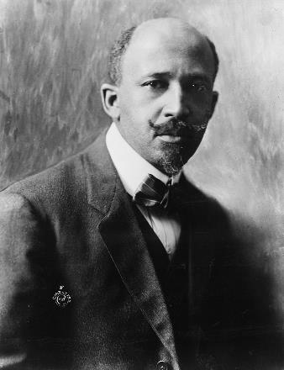
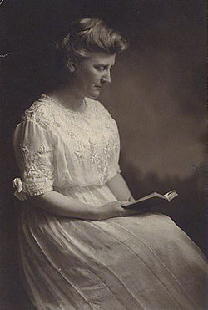
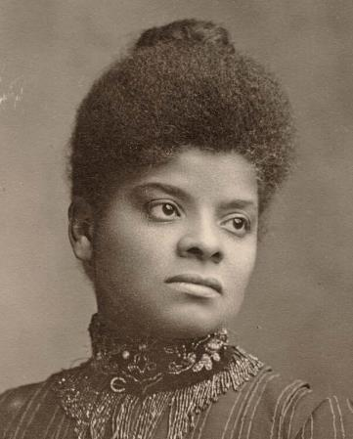
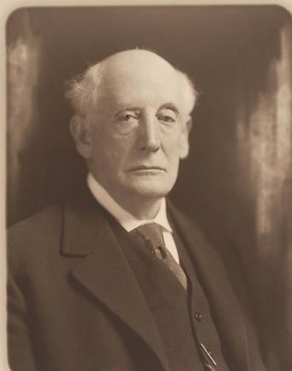
NAACP
Mary White Ovington
Scholar Exchange:
The Civil Rights Movement, the Warren Court, and Landmark Civil Rights Laws
The Civil Rights Movement, the Warren Court, and Landmark Civil Rights Laws
W.E.B. Du Bois
Ida B. Wells
Moorfield Stoley

Slide 6
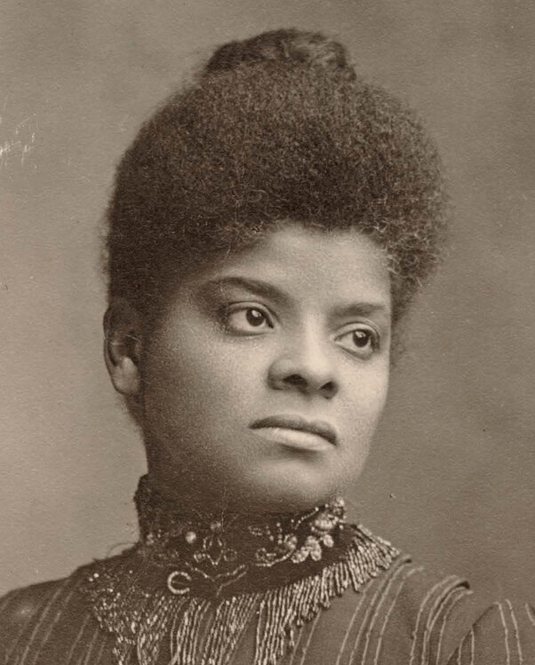
NAACP
Courageous journalist and civil rights figure. Studied white violence in the South in the late 1890s through the early 1900s. Much of what we know about Southern lynching during this period comes from Wells’s extraordinary work.
Scholar Exchange:
The Civil Rights Movement, the Warren Court, and Landmark Civil Rights Laws
The Civil Rights Movement, the Warren Court, and Landmark Civil Rights Laws
Ida B. Wells

Slide 7
NAACP
First African American to earn a Ph.D. at Harvard. A founder of the NAACP. Author of Black Reconstruction—an important early history of this critical period, placing African Americans at the center of the Reconstruction story.
Scholar Exchange:
The Civil Rights Movement, the Warren Court, and Landmark Civil Rights Laws
The Civil Rights Movement, the Warren Court, and Landmark Civil Rights Laws
W.E.B. Du Bois

Slide 8
NAACP
Scholar Exchange:
The Civil Rights Movement, the Warren Court, and Landmark Civil Rights Laws
Suffragist. Journalist. Co-Founder of the NAACP.
The Civil Rights Movement, the Warren Court, and Landmark Civil Rights Laws
Mary White Ovington

Slide 9
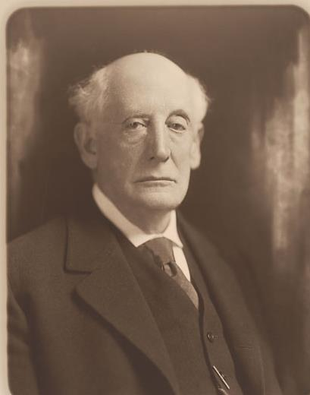
NAACP
Scholar Exchange:
The Civil Rights Movement, the Warren Court, and Landmark Civil Rights Laws
The Civil Rights Movement, the Warren Court, and Landmark Civil Rights Laws
Lawyer from Boston. Founding President: 1909-29.
Moorfield Storey

Slide 10
SOUTHERN CHRISTIAN LEADERSHIP CONFERENCE
The SCLC was formed in 1954 by Martin Luther King, Jr. (its first President), Ralph Abernathy, Ella Baker, Fred Shuttlesworth, and Bayard Rustin. It made nonviolence its central tenet and had a national focus, not grassroots.
Scholar Exchange:
The Civil Rights Movement, the Warren Court, and Landmark Civil Rights Laws
The Civil Rights Movement, the Warren Court, and Landmark Civil Rights Laws

Slide 11
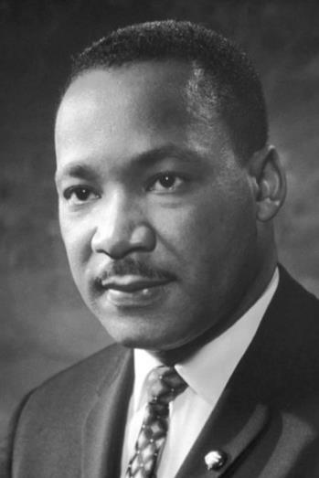
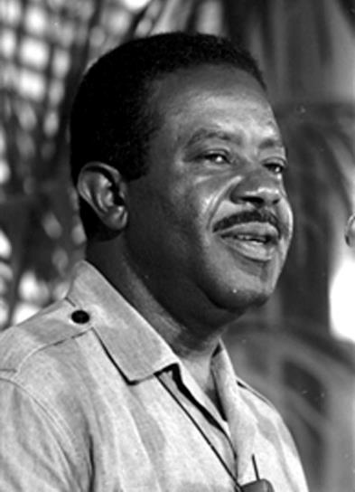
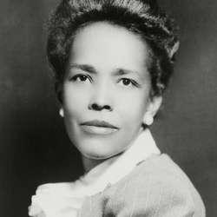
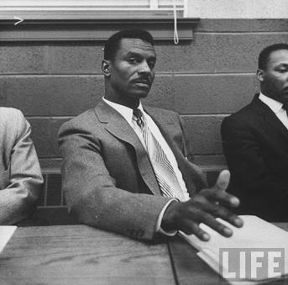
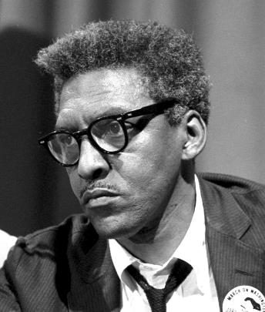
SOUTHERN CHRISTIAN LEADERSHIP CONFERENCE
Ralph Abernathy
Martin Luther King, Jr.
Scholar Exchange:
The Civil Rights Movement, the Warren Court, and Landmark Civil Rights Laws
The Civil Rights Movement, the Warren Court, and Landmark Civil Rights Laws
Bayard Rustin
Fred Shuttlesworth
Ella Baker

Slide 12
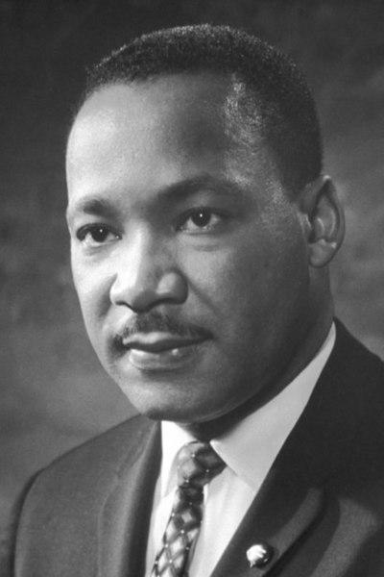
SOUTHERN CHRISTIAN LEADERSHIP CONFERENCE
Scholar Exchange:
The Civil Rights Movement, the Warren Court, and Landmark Civil Rights Laws
The Civil Rights Movement, the Warren Court, and Landmark Civil Rights Laws
Martin Luther King, Jr.

Slide 13
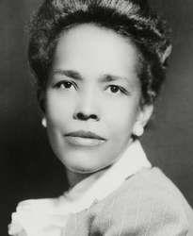
SOUTHERN CHRISTIAN LEADERSHIP CONFERENCE
Five-decade career. Largely a behind-the-scenes organizer. Worked with W.E.B. Du Bois, Thurgood Marshall, A. Philip Randolph, and Dr. King, among many others. Mentored Diane Nash, Stokely Carmichael, and Rosa Parks. She pushed to make sure that the Civil Rights Movement was not just a top-down movement, but also one from the grassroots up. And that the Civil Rights Movement wasn’t just run by men—that women would have a powerful voice in the movement, too.
Scholar Exchange:
The Civil Rights Movement, the Warren Court, and Landmark Civil Rights Laws
The Civil Rights Movement, the Warren Court, and Landmark Civil Rights Laws
Ella Baker

Slide 14
SOUTHERN CHRISTIAN LEADERSHIP CONFERENCE
Baptist minister. Close friend and mentor to Dr. King. Worked with Dr. King on the Montgomery Bus Boycott. Co-Founder of SCLC. Became President of the organization after King’s assassination.
Scholar Exchange:
The Civil Rights Movement, the Warren Court, and Landmark Civil Rights Laws
The Civil Rights Movement, the Warren Court, and Landmark Civil Rights Laws
Ralph Abernathy

Slide 15
SOUTHERN CHRISTIAN LEADERSHIP CONFERENCE
Minister from Birmingham. Co-Founder of SCLC. Ally of Dr. King.
Scholar Exchange:
The Civil Rights Movement, the Warren Court, and Landmark Civil Rights Laws
The Civil Rights Movement, the Warren Court, and Landmark Civil Rights Laws
Fred Shuttlesworth

Slide 16
SOUTHERN CHRISTIAN LEADERSHIP CONFERENCE
Ally of A. Philip Randolph. Trailblazer of non-violent, direct action. Taught Dr. King those principles. Helped organize the Freedom Rides and the March on Washington.
Scholar Exchange:
The Civil Rights Movement, the Warren Court, and Landmark Civil Rights Laws
The Civil Rights Movement, the Warren Court, and Landmark Civil Rights Laws
Bayard Rustin

Slide 17
CONGRESS OF RACIAL EQUALITY
Formed in 1942 by James L. Farmer, Jr., George Houser, and Bernice Fisher. CORE’s goal was to “bring about equality for all people regardless of race, creed, sex, age, disability, sexual orientation, religion or ethnic background.”
The group was inspired by the example of Mahatma Gandhi’s teachings of non-violent resistance. Of the 50 original members, 22 were women.
Scholar Exchange:
The Civil Rights Movement, the Warren Court, and Landmark Civil Rights Laws
The Civil Rights Movement, the Warren Court, and Landmark Civil Rights Laws

Slide 18
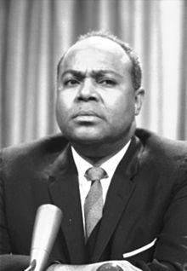
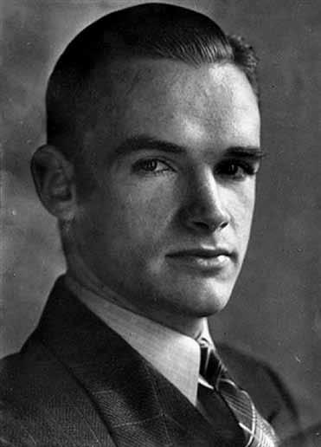
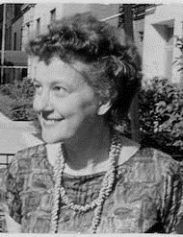
CONGRESS OF RACIAL EQUALITY
Scholar Exchange:
The Civil Rights Movement, the Warren Court, and Landmark Civil Rights Laws
The Civil Rights Movement, the Warren Court, and Landmark Civil Rights Laws
James L. Farmer, Jr.
George Houser
Bernice Fisher

Slide 19
CONGRESS OF RACIAL EQUALITY
Scholar Exchange:
The Civil Rights Movement, the Warren Court, and Landmark Civil Rights Laws
The Civil Rights Movement, the Warren Court, and Landmark Civil Rights Laws
Committed to non-violence. Organized the first Freedom Ride.
James L. Farmer, Jr.

Slide 20
CONGRESS OF RACIAL EQUALITY
Scholar Exchange:
The Civil Rights Movement, the Warren Court, and Landmark Civil Rights Laws
The Civil Rights Movement, the Warren Court, and Landmark Civil Rights Laws
Methodist Minister. Co-Founded CORE.
George Houser

Slide 21
CONGRESS OF RACIAL EQUALITY
Scholar Exchange:
The Civil Rights Movement, the Warren Court, and Landmark Civil Rights Laws
Co-Founder of CORE.
Based in Chicago. “Godmother” of the sit-in movement.
The Civil Rights Movement, the Warren Court, and Landmark Civil Rights Laws
Bernice Fisher

Slide 22
LEADERSHIP CONFERENCE ON CIVIL RIGHTS (LCCR)
Founded in 1950 by Roy Wilkins, A. Philip Randolph, and Arnold Aronson. LCCR coordinated the national legislative campaigns behind every major piece of civil rights legislation during this era.
It still plays a huge role in the civil rights community today.
Scholar Exchange:
The Civil Rights Movement, the Warren Court, and Landmark Civil Rights Laws
The Civil Rights Movement, the Warren Court, and Landmark Civil Rights Laws
Notes:
ldukes1@kent.edu

Slide 23
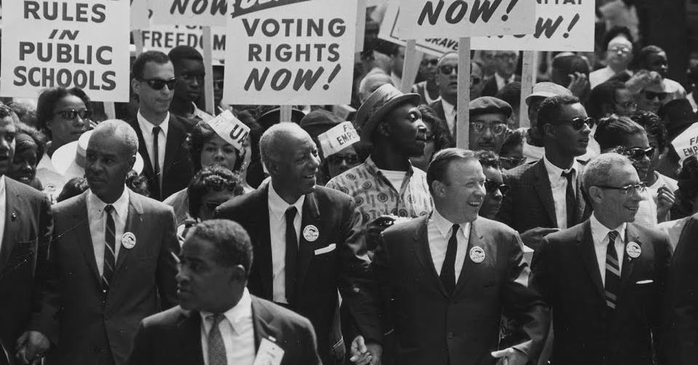
LEADERSHIP CONFERENCE ON CIVIL RIGHTS
Roy Wilkins
Scholar Exchange:
The Civil Rights Movement, the Warren Court, and Landmark Civil Rights Laws
The Civil Rights Movement, the Warren Court, and Landmark Civil Rights Laws
A. Philip Randolph
Arnold Aronson

Slide 24
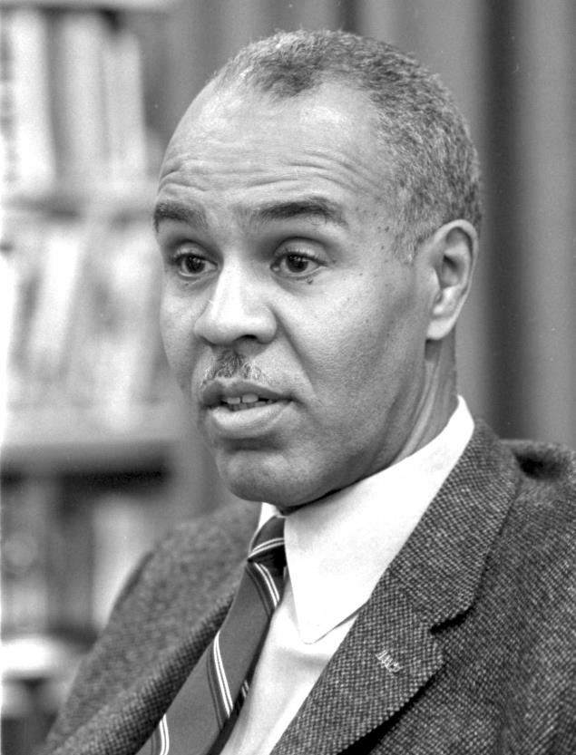
LEADERSHIP CONFERENCE ON CIVIL RIGHTS
Scholar Exchange:
The Civil Rights Movement, the Warren Court, and Landmark Civil Rights Laws
The Civil Rights Movement, the Warren Court, and Landmark Civil Rights Laws
Active from the 1930s to the 1970s. Also served as Executive Secretary of the NAACP from 1955-63.
Roy Wilkins

Slide 25
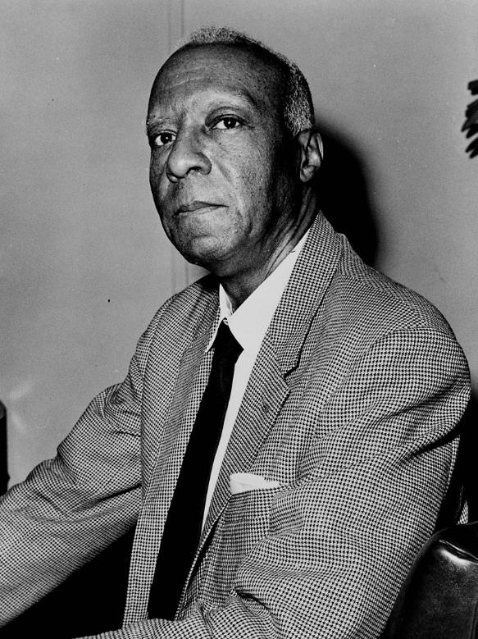
LEADERSHIP CONFERENCE ON CIVIL RIGHTS
Scholar Exchange:
The Civil Rights Movement, the Warren Court, and Landmark Civil Rights Laws
The Civil Rights Movement, the Warren Court, and Landmark Civil Rights Laws
Prominent labor organizer and civil rights activist
A. Philip Randolph

Slide 26
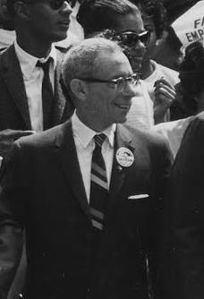
LEADERSHIP CONFERENCE ON CIVIL RIGHTS
Scholar Exchange:
The Civil Rights Movement, the Warren Court, and Landmark Civil Rights Laws
The Civil Rights Movement, the Warren Court, and Landmark Civil Rights Laws
Founder of LCCR. Executive Secretary: 1950-80. Worked with Randolph to lobby FDR. Helped plan the March on Washington.
Arnold Aronson

Slide 27
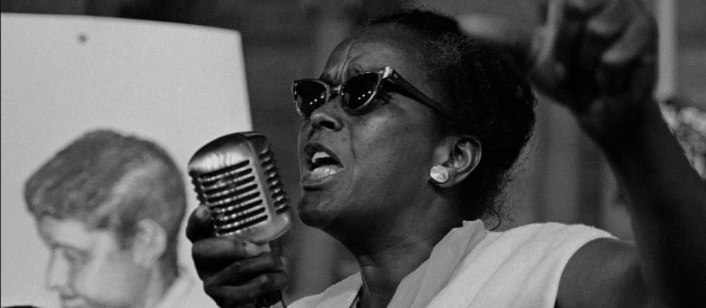
STUDENT NONVIOLENT COORDINATING COMMITTEE
Scholar Exchange:
The Civil Rights Movement, the Warren Court, and Landmark Civil Rights Laws
The Civil Rights Movement, the Warren Court, and Landmark Civil Rights Laws
Ella Baker
Represented the next generation of leadership in the Civil Rights Movement. SNCC was formed in April 1960 at a conference at Shaw University in Raleigh, North Carolina.
It grew out of the beginning of the sit-in movement earlier that year—with Ella Baker playing a key role.

Slide 28
STUDENT NONVIOLENT COORDINATING COMMITTEE
Baker supported a more egalitarian leadership structure. She wanted the Civil Rights Movement to look more like the Black Church, with men and women in leadership positions. She questioned the top-down leadership of organizations like SCLC, saying “strong people don’t need strong leaders.” She quit the SCLC to support the formation of SNCC. She convinced SNCC to form two wings—one for direct action, and the other for voter registration drives. With CORE, she helped coordinate the Freedom Rides in 1961.
Baker helped support and teach the student leadership of SNCC, including Diane Nash, Julian Bond, John Lewis, Stokely Carmichael, Bob Moses, and Bernice Johnson Reagan.
Scholar Exchange:
The Civil Rights Movement, the Warren Court, and Landmark Civil Rights Laws
The Civil Rights Movement, the Warren Court, and Landmark Civil Rights Laws

Slide 29
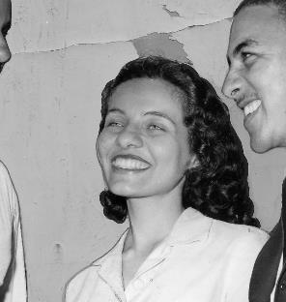
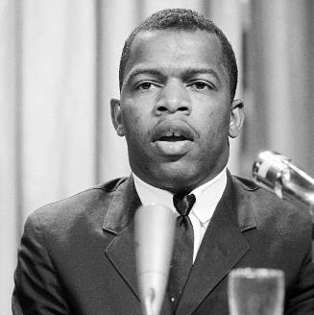
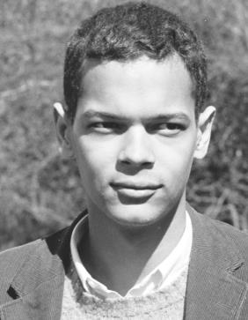
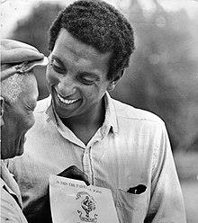
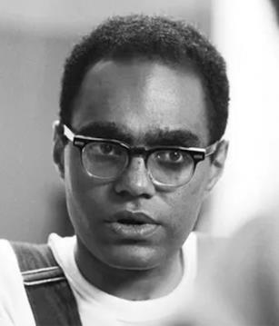
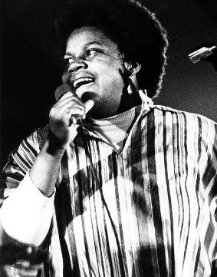
STUDENT NONVIOLENT COORDINATING COMMITTEE
Scholar Exchange:
The Civil Rights Movement, the Warren Court, and Landmark Civil Rights Laws
The Civil Rights Movement, the Warren Court, and Landmark Civil Rights Laws
Diane Nash
John Lewis
Julian Bond
Stokely Carmichael
Bob Moses
Bernice Johnson Reagon

Slide 30
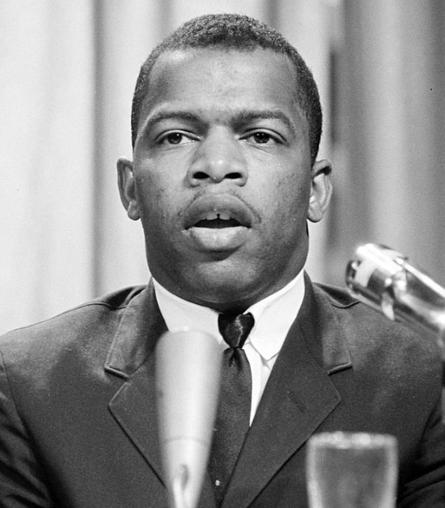
STUDENT NONVIOLENT COORDINATING COMMITTEE
Chair of SNCC: 1963-66.
Skull fractured at Selma. Youngest speaker at the March on Washington. Among the “Big Six” leaders that organized it. One of the thirteen original Freedom Riders.
Scholar Exchange:
The Civil Rights Movement, the Warren Court, and Landmark Civil Rights Laws
The Civil Rights Movement, the Warren Court, and Landmark Civil Rights Laws
John Lewis

Slide 31
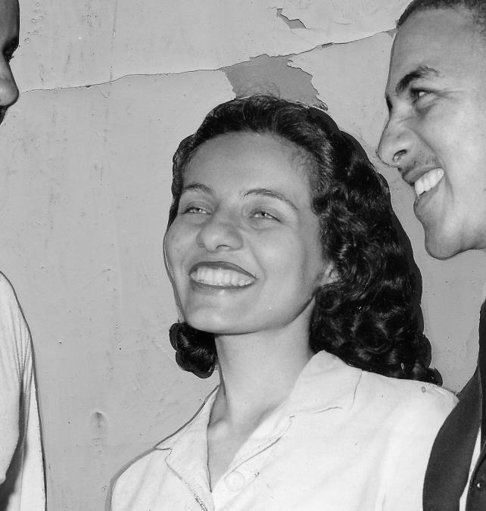
STUDENT NONVIOLENT COORDINATING COMMITTEE
Worked to integrate lunch counters in Nashville. Freedom Rides. Co-Founder of SNCC. Participated in the Selma voting rights movement, too.
Scholar Exchange:
The Civil Rights Movement, the Warren Court, and Landmark Civil Rights Laws
The Civil Rights Movement, the Warren Court, and Landmark Civil Rights Laws
Diane Nash

Slide 32
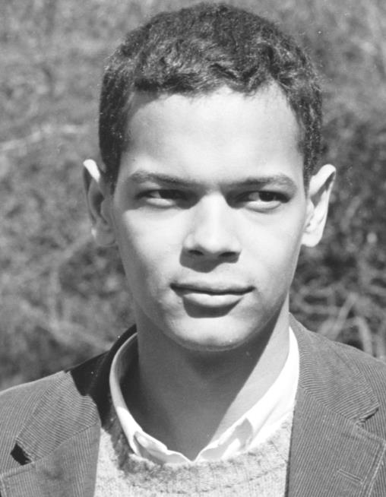
STUDENT NONVIOLENT COORDINATING COMMITTEE
Scholar Exchange:
The Civil Rights Movement, the Warren Court, and Landmark Civil Rights Laws
The Civil Rights Movement, the Warren Court, and Landmark Civil Rights Laws
Helped found SNCC. Later, the Southern Poverty Law Center (1971).
Julian Bond

Slide 33
STUDENT NONVIOLENT COORDINATING COMMITTEE
Scholar Exchange:
The Civil Rights Movement, the Warren Court, and Landmark Civil Rights Laws
The Civil Rights Movement, the Warren Court, and Landmark Civil Rights Laws
Later, a leader in the Black Power movement and the Black Panthers.
Stokely Carmichael

Slide 34
STUDENT NONVIOLENT COORDINATING COMMITTEE
Scholar Exchange:
The Civil Rights Movement, the Warren Court, and Landmark Civil Rights Laws
The Civil Rights Movement, the Warren Court, and Landmark Civil Rights Laws
Voter education and registration in Mississippi.
Bob Moses

Slide 35
STUDENT NONVIOLENT COORDINATING COMMITTEE
Scholar Exchange:
The Civil Rights Movement, the Warren Court, and Landmark Civil Rights Laws
The Civil Rights Movement, the Warren Court, and Landmark Civil Rights Laws
Songwriter and composer. Founding member of SNCC. Showed the power of collective singing to bring people together.
Bernice Johnson Reagon

Slide 36
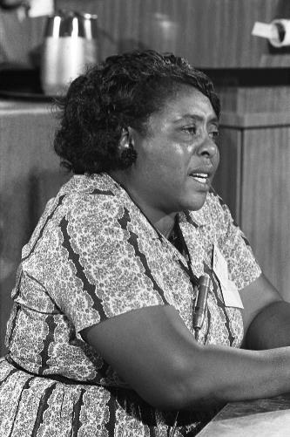
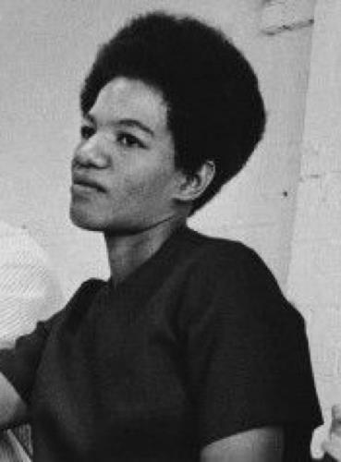
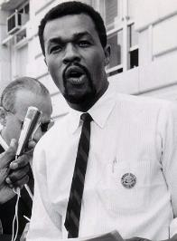
STUDENT NONVIOLENT COORDINATING COMMITTEE
Other young leaders who emerged from SNCC included Fannie Lou Hamer, Ruby Doris Smith Robinson, James Bevar, and Marion Barry.
Scholar Exchange:
The Civil Rights Movement, the Warren Court, and Landmark Civil Rights Laws
The Civil Rights Movement, the Warren Court, and Landmark Civil Rights Laws
Fannie Lou Hamer
Ruby Doris Smith Robinson
Marion Barry

Slide 37
THE COMMITTEE FOR EQUAL JUSTICE
The group was founded by Rosa Parks and Recy Taylor in 1944 and focused on equality for African American women. Parks and Taylor helped found the group, in part, to bring greater attention to violence against African American women.
The Civil Rights Movement, the Warren Court, and Landmark Civil Rights Laws

Slide 38
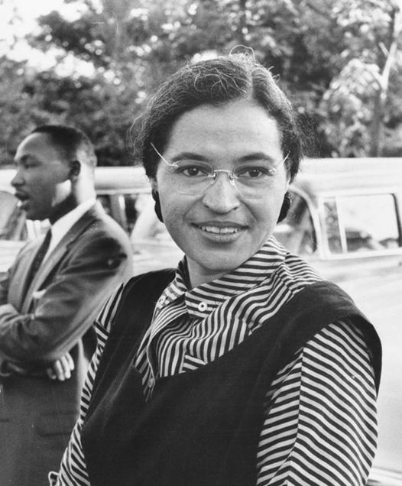
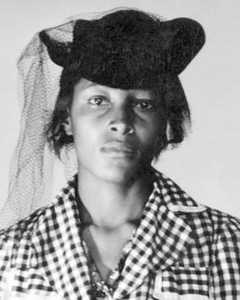
THE COMMITTEE FOR EQUAL JUSTICE
The Civil Rights Movement, the Warren Court, and Landmark Civil Rights Laws
Rosa Parks
Recy Taylor

Slide 39
THE COMMITTEE FOR EQUAL JUSTICE
Rosa Parks was already the secretary of the Montgomery Chapter of the NAACP—a position that she held for 14 years.
The Civil Rights Movement, the Warren Court, and Landmark Civil Rights Laws
Rosa Parks

Slide 40
THE COMMITTEE FOR EQUAL JUSTICE
The Civil Rights Movement, the Warren Court, and Landmark Civil Rights Laws
Recy Taylor

Slide 41
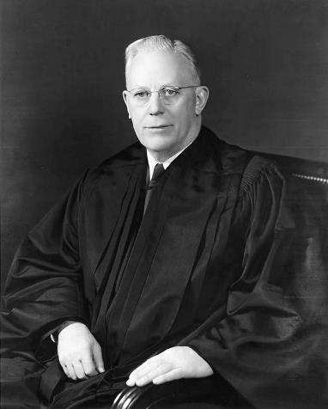
THE WARREN COURT
Finally, the Supreme Court also played a key role during the Civil Rights Era.
The Warren Court—led by Chief Justice Earl Warren—ran from 1953 through 1969.
The Civil Rights Movement, the Warren Court, and Landmark Civil Rights Laws
Chief Justice Earl Warren

Slide 42
THE WARREN COURT
This is the Court of Brown v. Board of Education (declaring school segregation unconstitutional) and other landmark decisions—allying the Supreme Court with the growing Civil Rights Movement in the 1960s.
For much of its history, the Supreme Court was no ally of civil rights reformers.
That changed with the Warren Court—with Chief Justice Warren and his colleagues carving out an important role for the Supreme Court in protecting minority rights, especially those of unpopular groups (like African Americans) that often couldn’t rely on elected officials to protect them.
The Civil Rights Movement, the Warren Court, and Landmark Civil Rights Laws

Slide 43
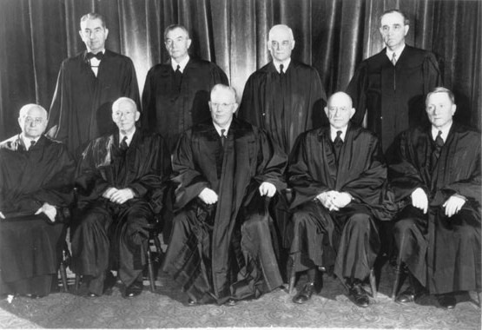
THE WARREN COURT
The Civil Rights Movement, the Warren Court, and Landmark Civil Rights Laws
Warren Court Pictured in 1953
Back row (left to right): Tom Clark, Robert H. Jackson, Harold Burton, and Sherman Minton
Front row (left to right): Felix Frankfurter, Hugo Black, Earl Warren, Stanley Reed, and William O. Douglas

Slide 44
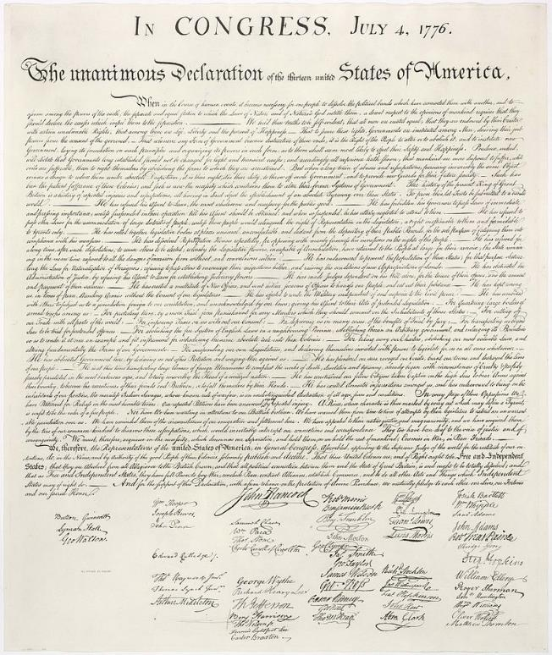
DECLARATION OF INDEPENDENCE 1776
“We hold these truths to be self-evident, that all men are created equal, endowed by their creator with the natural rights of “life, liberty, and the pursuit of happiness.”
The Civil Rights Movement, the Warren Court, and Landmark Civil Rights Laws

Slide 45
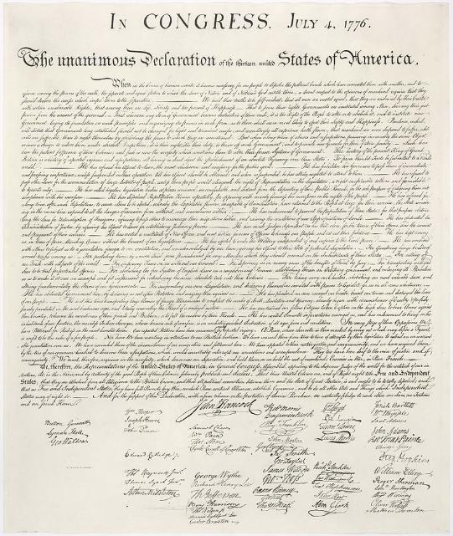
DECLARATION OF INDEPENDENCE 1776
Constitutional reformers across history have laid claim to this promise—arguing that the Declaration’s promise of freedom and equality has been at the core of our nation’s purpose since the very beginning and arguing that for much of our nation’s history we have failed to live up to its inspiring words.
The Civil Rights Movement, the Warren Court, and Landmark Civil Rights Laws

Slide 46
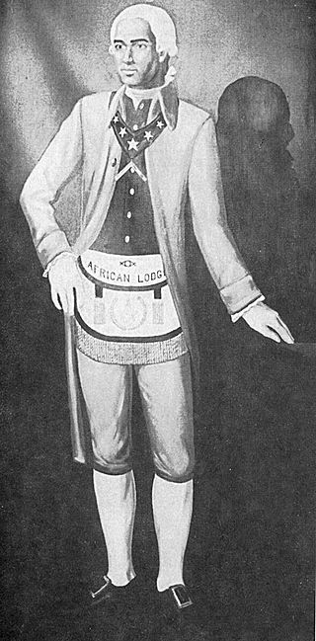
1777 petition pushed for the Massachusetts legislature to realize the Declaration of Independence’s promise and abolish slavery in the state.
The Civil Rights Movement, the Warren Court, and Landmark Civil Rights Laws
PRINCE HALL

Slide 47
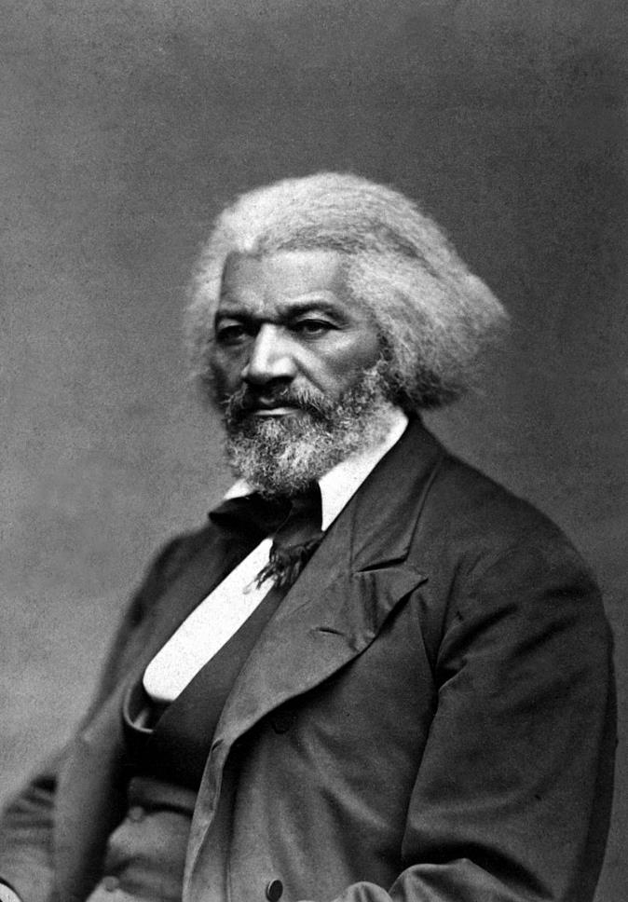
“What is to a Slave the Fourth of July?” speech challenged his white audience to live up to the words of their Founding creed and its promise of freedom and equality for everyone.
The Civil Rights Movement, the Warren Court, and Landmark Civil Rights Laws
FREDERICK DOUGLASS

Slide 48
Described the Declaration (and the Constitution) as a “promissory note” issued to all Americans, regardless of their race.
The Civil Rights Movement, the Warren Court, and Landmark Civil Rights Laws
DR. MARTIN LUTHER KING, JR.

Slide 49
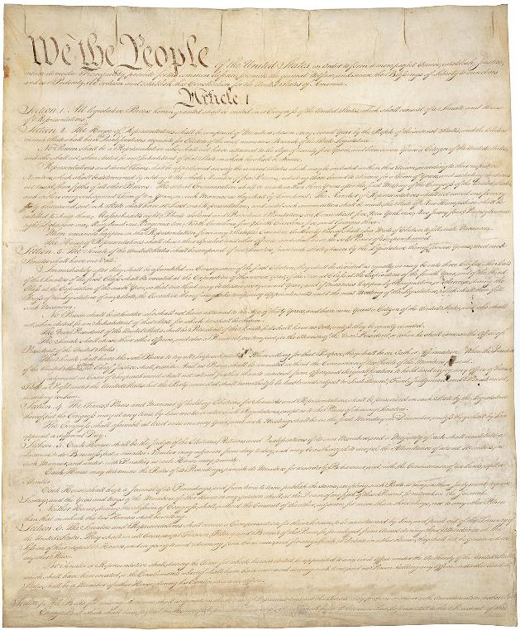
THE CONSTITUTION 1787
“We the People”
The Civil Rights Movement, the Warren Court, and Landmark Civil Rights Laws

Slide 50
THE “SECOND FOUNDING AND THE RECONSTRUCTION AMENDMENTS
The 13th Amendment abolished slavery (1865).
The 14th Amendment wrote the Declaration of Independence’s promise of freedom and equality into the Constitution. (1868).
The 15 Amendment banned racial discrimination in voting (1870).
The Civil Rights Movement, the Warren Court, and Landmark Civil Rights Laws

Slide 51
POWERS OF CONGRESS
Some civil rights advocates drew especially on the powers granted to Congress to eradicate racial discrimination in America
The original Constitution granted Congress the power to regulate interstate commerce—granting it broad powers to pass laws touching on our nation’s economy
The Reconstruction Amendments themselves contained enforcement clauses—granting Congress new powers to protect the civil and political rights of all Americans
During the Civil Rights Era, reformers drew on these powers to fight for landmark civil rights laws.
The Civil Rights Movement, the Warren Court, and Landmark Civil Rights Laws

Slide 52
THE 23RD AMENDMENT
1961
Granted the District of Columbia (and its large African American population) three electoral votes and added their voters’ voices to the presidential selection process.
The Civil Rights Movement, the Warren Court, and Landmark Civil Rights Laws

Slide 53
THE 24TH AMENDMENT
1964
Banned poll taxes in national elections.
The Civil Rights Movement, the Warren Court, and Landmark Civil Rights Laws

Slide 54
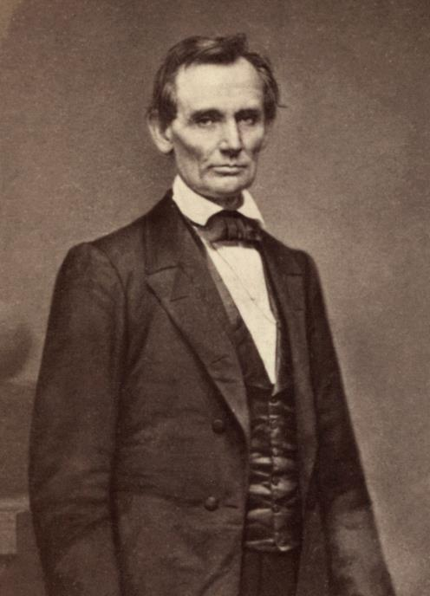
THE RECONSTRUCTION ERA
The period after the Civil War is known as Reconstruction.
During this critical period, the Republican Party tried to set important constitutional baselines for post-Civil War America.
Importantly, the American people wrote many of these baselines into the Reconstruction Amendments: the 13th, 14th, and 15th
The Civil Rights Movement, the Warren Court, and Landmark Civil Rights Laws
ABRAHAM LINCOLN

Slide 55
THE RECONSTRUCTION ERA
During this period we saw African Americans:
Meeting in conventions throughout the nation—laying out their vision of what America’s “new birth of freedom” ought to look like for the African American community in post-Civil War America.
Voting in massive numbers—electing Republicans throughout the South and pushing for the ratification of the 14th and 15th Amendments.
Holding office at all levels of government--U.S. Senators, U.S. House Members, governors, state legislators, all the way down to key positions in local governments throughout the South
And we saw the national government—for a time—acting to protect the constitutional rights of all.
The Civil Rights Movement, the Warren Court, and Landmark Civil Rights Laws

Slide 56
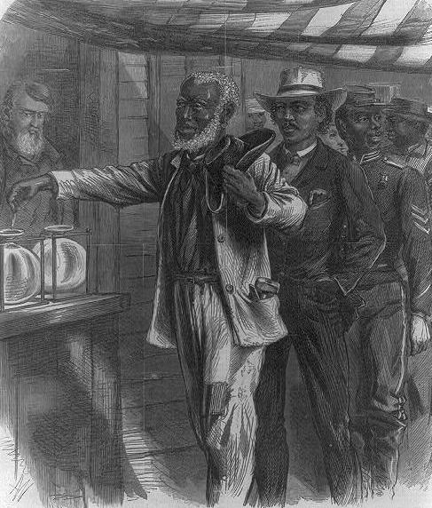
The Civil Rights Movement, the Warren Court, and Landmark Civil Rights Laws
“THE FIRST VOTE"
A.R. WAUD, WOOD ENGRAVING, 1867
LOC PRINTS & PHOTOGRAPHS DIVISION

Slide 57
THE JIM CROW SOUTH
Over time, white Southerners regained political power and imposed second-class citizenship on African Americans.
This system of Jim Crow segregation forced African Americans to attend different schools than white Americans, drink from different water fountains, use different restrooms, travel in different train cars, and stay in different hotels—and on and on.
These states also used a mix of violence, intimidation, and laws on the books—including polls taxes and literacy tests—to keep African Americans from voting.
The Civil Rights Movement, the Warren Court, and Landmark Civil Rights Laws

Slide 58
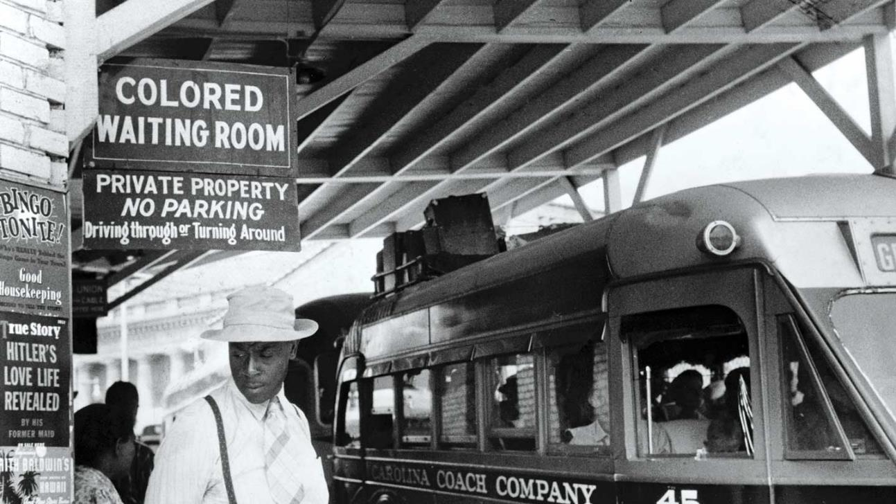
Image: Durham, North Carolina Bus Station, 1940. (Library of Congress)
PLESSY V. FERGUSON
(1896)
The Civil Rights Movement, the Warren Court, and Landmark Civil Rights Laws

Slide 59
PLESSY V. FERGUSON
(1896)
In 1896, the Supreme Court—in the infamous case of Plessy v. Ferguson (1896)—said that Jim Crow segregation was constitutional.
For the Plessy Court (in a 7-1 ruling), this form of discrimination didn’t violate the Fourteenth Amendment’s promise of equality. According to Justice Henry Billings Brown and the Plessy majority, separate, but equal, was okay for the Plessy Justices.
The Civil Rights Movement, the Warren Court, and Landmark Civil Rights Laws

Slide 60
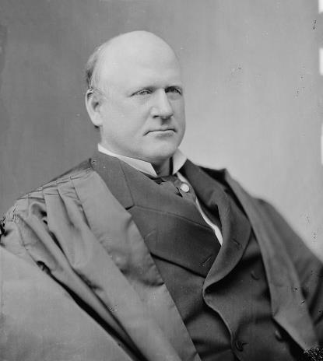
PLESSY V. FERGUSON
(1896)
Justice John Marshall Harlan was the lone dissenter.
His dissent is one of the most important (and powerful) opinions in Supreme Court history—arguing that “Our constitution is color-blind” and predicting that the Plessy decision “will, in time, prove to be quite as pernicious as the decision made by this tribunal in the Dred Scott case.”
The Civil Rights Movement, the Warren Court, and Landmark Civil Rights Laws
Justice John Marshall Harlan

Slide 61
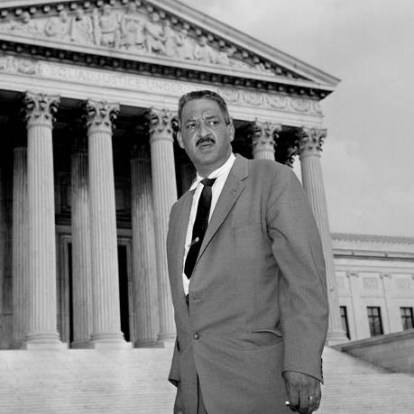
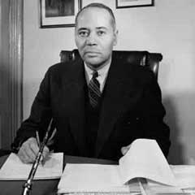
NAACP LEGAL TEAM
In response to Plessy the NAACP eventually adopted a long-term strategy for fighting for racial equality. Lawyers prepared the ground in a series of cases challenging racial discrimination.
The Civil Rights Movement, the Warren Court, and Landmark Civil Rights Laws
CHARLES HAMILTON HOUSTON
THURGOOD MARSHALL
WILLIAM HASTIE

Slide 62
NAACP LEGAL TEAM
Dean of Howard Law School. First NAACP special counsel. Graduated from Amherst and Harvard Law School.
The Civil Rights Movement, the Warren Court, and Landmark Civil Rights Laws
CHARLES HAMILTON HOUSTON

Slide 63
NAACP LEGAL TEAM
Also, a Dean of Howard Law School. Taught Thurgood Marshall. Later, Governor of the Virgin Islands. And a Federal judge (including on the Third Circuit).
The Civil Rights Movement, the Warren Court, and Landmark Civil Rights Laws
WILLIAM HASTIE

Slide 64
NAACP LEGAL TEAM
Marshall was the great-grandson of enslaved people and came from modest origins, graduating from Lincoln University in 1930, a prestigious African-American school near Philadelphia. But he was also denied admission to the University of Maryland Law School on account of race.
He enrolled at Howard Law School and met Charles Hamilton Houston.
The Civil Rights Movement, the Warren Court, and Landmark Civil Rights Laws
THURGOOD MARSHALL

Slide 65
BROWN V. BOARD (1954)
The Civil Rights Movement, the Warren Court, and Landmark Civil Rights Laws
LINDA BROWN

Slide 66
BROWN V. BOARD (1954)
Brown combined similar cases which all involved African American students who had been denied admission to white public schools. The challengers argued that these segregation laws violated the 14th’s Amendment’s Equal Protection Clause and that separate could never be equal in public education.
The Civil Rights Movement, the Warren Court, and Landmark Civil Rights Laws
The students for whom the famous Brown v. Board of Education case was brought, with their parents. (Credit: Carl Iwasaki/The LIFE Images Collection/Getty Images)

Slide 67
BROWN V. BOARD (1954)
In Brown, the Supreme Court unanimously overturned Plessy and concluded that school segregation violated the 14th Amendment’s promise of equality and was unconstitutional.
Chief Justice Warren: “We conclude that in the field of public education the doctrine of ‘separate but equal’ has no place. Separate educational facilities are inherently unequal.”
The Civil Rights Movement, the Warren Court, and Landmark Civil Rights Laws
CHIEF JUSTICE EARL WARREN

Slide 68
THE ROAD TO BROWN
By the time the Court issued its Brown opinion, they had already struck down other Jim Crow laws, like racial covenants, racial zoning schemes, “All White” primaries, “Grandfather Clauses,” and discrimination in labor unions.
In Sweatt v. Painter (1950) the Court already questioned the “separate but equal” doctrine of Plessy. Herman Sweatt was refused admission to the University of Texas Law School on the basis of race. The Court ruled that this was unconstitutional under Equal Protection.
And in another case—McLaurin v. Oklahoma—the Court decided segregation in higher education violated Equal Protection.
The Civil Rights Movement, the Warren Court, and Landmark Civil Rights Laws

Slide 69
LITTLE ROCK
In 1957, backlash reached a crisis point in Little Rock, Arkansas.
Nine black students—the “Little Rock Nine”—attempted to enroll at the all-white Central High School.
Governor Orval Faubus called out the National Guard to bar them, with the support of white mobs.
The Civil Rights Movement, the Warren Court, and Landmark Civil Rights Laws

Slide 70
LITTLE ROCK
President Eisenhower then sent troops to protect the African American students. In a powerful speech, Ike addressed the nation—explaining his decision.
Finally, the Warren Court stepped in to reinforce Ike’s actions in Cooper v. Aaron (1958). There, the Court explained that state officers and governors had a duty to obey the orders of the Court, which rested on the Court’s interpretation of the Constitution.
The Civil Rights Movement, the Warren Court, and Landmark Civil Rights Laws
DWIGHT D. EISENHOWER

Slide 71
MONTGOMERY BUS BOYCOTT
Rosa Parks was a civil rights activist in Montgomery, Alabama. On December 1, 1955, she refused to give up her seat on a bus to a white man. She was arrested for violating the law. But she was acting as part of a larger advocacy strategy. Parks herself was a longtime member of the NAACP. And she and other female activists in the area had been planning such action for some time.
Parks’s arrest became a galvanizing force for the African American community’s challenge to segregated buses in Montgomery—one of the most segregated cities in the nation. The boycott lasted over a year.
The Civil Rights Movement, the Warren Court, and Landmark Civil Rights Laws

Slide 72
NATIONAL STUDENT-LED SIT-IN MOVEMENT
In 1960, we see the beginning of the student-led sit-in movement in Greensboro, North Carolina. This movement would spread to Nashville, Atlanta, and other major cities.
As part of a “sit-in,” student activists would enter a segregated public place—like a grocery counter—and sit in the “whites-only” areas.
The Civil Rights Movement, the Warren Court, and Landmark Civil Rights Laws

Slide 73
FREEDOM RIDES
In 1961, the Congress for Racial Equality began to sponsor the Freedom Rides. As part of the Freedom Rides, civil rights advocates boarded interstate buses in the South in mixed racial groups to challenge local laws or customs that enforced segregation in bus seating. The first riders were met with violence in Alabama. The violence against the Freedom Riders bolstered support for the Civil Rights Movement nationally.
The Civil Rights Movement, the Warren Court, and Landmark Civil Rights Laws

Slide 74
JAMES MEREDITH
In 1962, James Meredith forced the integration of the University of Mississippi. The University had denied him admissions twice. But with the support of the NAACP and Medgar Evers, a federal court ruled that Meredith had a right to attend a state school.
The Supreme Court upheld that ruling. Riots broke out, and President Kennedy nationalized the Mississippi National Guard to enforce the Court’s decision. The University eventually enrolled Meredith, and he graduated the following year.
The Civil Rights Movement, the Warren Court, and Landmark Civil Rights Laws

Slide 75
CHILDREN’S MARCH 1963
The Civil Rights Movement, the Warren Court, and Landmark Civil Rights Laws

Slide 76
LETTER FROM BIRMINGHAM JAIL
In 1963, Dr. King published one of his most famous works, Letter from a Birmingham Jail, after being arrested for attending a demonstration, which had been barred. King framed his letter as a response to a group of white Southern ministers who had expressed concern about the civil unrest associated with the civil rights demonstrations.
Scholar Exchange:
The Civil Rights Movement, the Warren Court, and Landmark Civil Rights Laws
The Civil Rights Movement, the Warren Court, and Landmark Civil Rights Laws
Martin Luther King, Jr.

Slide 77
LETTER FROM BIRMINGHAM JAIL
While many white ministers attacked King’s advocacy in Birmingham as unwise, he explained that he went to Birmingham because injustice was there.
“We are caught in an inescapable network of mutuality, tied in a single garment of destiny. Whatever affects one directly, affects all indirectly.”
Scholar Exchange:
The Civil Rights Movement, the Warren Court, and Landmark Civil Rights Laws
The Civil Rights Movement, the Warren Court, and Landmark Civil Rights Laws
Martin Luther King, Jr.

Slide 78
LETTER FROM BIRMINGHAM JAIL
“We have waited for more than 340 years for our constitutional and God-given rights. . . . Perhaps it is easy for those who have never felt the stinging darts of segregation to say, ‘Wait.’”
Scholar Exchange:
The Civil Rights Movement, the Warren Court, and Landmark Civil Rights Laws
The Civil Rights Movement, the Warren Court, and Landmark Civil Rights Laws
Martin Luther King, Jr.

Slide 79
LETTER FROM BIRMINGHAM JAIL
The white ministers criticize the Civil Rights Movement with breaking the laws. They ask how civil rights leaders can ask others to follow Brown while we break laws ourselves.
King concedes that this is a legitimate concern. But it turns on the fact that some laws are just and some are unjust. King says that we should follow the just ones. But we have a moral obligation to disobey unjust laws.
But for King, if you break an unjust law, you must do so openly, lovingly, and with a willingness to accept the penalty. This is the highest respect for the law.
Scholar Exchange:
The Civil Rights Movement, the Warren Court, and Landmark Civil Rights Laws
The Civil Rights Movement, the Warren Court, and Landmark Civil Rights Laws

Slide 80
LETTER FROM BIRMINGHAM JAIL
“One day the South will recognize its real heroes. . . . One day the South will know that when these disinherited children of God sat down at lunch counters, they were in reality standing up for what is best in the American dream and for the most sacred values in our Judaeo Christian heritage, thereby bringing our nation back to those great wells of democracy which were dug deep by the founding fathers in their formulation of the Constitution and the Declaration of Independence.”
Scholar Exchange:
The Civil Rights Movement, the Warren Court, and Landmark Civil Rights Laws
The Civil Rights Movement, the Warren Court, and Landmark Civil Rights Laws
Martin Luther King, Jr.

Slide 81
1963 MARCH ON WASHINGTON
The Civil Rights Movement, the Warren Court, and Landmark Civil Rights Laws

Slide 82
“I HAVE A DREAM” SPEECH
The Civil Rights Movement, the Warren Court, and Landmark Civil Rights Laws
Martin Luther King, Jr.

Slide 83
“I HAVE A DREAM” SPEECH
“In a sense we’ve come to our nation’s capital to cash a check. When the architects of our Republic wrote the magnificent words of the Constitution and the Declaration of Independence, they were signing a promissory note to which every American was to fall heir. This note was a promise that all men—yes, black men as well as white men—would be guaranteed the unalienable rights of life, liberty, and the pursuit of happiness. It is obvious today that America has defaulted on this promissory note insofar as her citizens of color are concerned. Instead of honoring this sacred obligation, America has given the Negro people a bad check; a check which has come back marked ‘insufficient funds.’”
The Civil Rights Movement, the Warren Court, and Landmark Civil Rights Laws
Martin Luther King, Jr.

Slide 84
“I HAVE A DREAM” SPEECH
“But we refuse to believe that the bank of justice is bankrupt. We refuse to believe that there are insufficient funds in the great vaults of opportunity of this nation. So, we have come to cash this check—a check that will give us upon demand the riches of freedom and the security of justice.”
The Civil Rights Movement, the Warren Court, and Landmark Civil Rights Laws
Martin Luther King, Jr.

Slide 85
“I HAVE A DREAM” SPEECH
“No, no, we are not satisfied, and we will not be satisfied until justice rolls down like water and righteousness like a mighty stream.”
The Civil Rights Movement, the Warren Court, and Landmark Civil Rights Laws
Martin Luther King, Jr.

Slide 86
“I HAVE A DREAM” SPEECH
“I say to you today, my friends, though, even though we face the difficulties of today and tomorrow, I still have a dream. It is a dream deeply rooted in the American dream. I have a dream that one day this nation will rise up and live out the true meaning of its creed.” [QUOTES DECLARATION.]
The Civil Rights Movement, the Warren Court, and Landmark Civil Rights Laws
Martin Luther King, Jr.

Slide 87
“I HAVE A DREAM” SPEECH
“With this faith we will be able to work together, to pray together, to struggle together, to go to jail together, to stand up for freedom together, knowing that we will be free one day.”
The Civil Rights Movement, the Warren Court, and Landmark Civil Rights Laws
Martin Luther King, Jr.

Slide 88
CIVIL RIGHTS ACT OF 1964
With the Civil Rights Act of 1964, Congress attacked racial discrimination in a variety of settings, including work, schools, and public settings (like restaurants and hotels).
Congress passed this law under its Article I power to regulate interstate commerce, but it can also be understood as realizing the promise of the Reconstruction Amendments.
The Civil Rights Movement, the Warren Court, and Landmark Civil Rights Laws
THE SIGNING OF THE CIVIL RIGHTS ACT, 1964

Slide 89
CIVIL RIGHTS ACT OF 1964
Shortly after Congress passed the Civil Rights Act of 1964, the Supreme Court considered a challenge to its constitutionality—Heart of Atlanta Motel v. United States (1964). There, a motel owner refused to rent rooms to African Americans, arguing that the Civil Rights Act exceeded Congress’s Commerce Clause powers.
The Warren Court upheld the Act. Congress was clear that the key purpose behind the Act was to end “the deprivation of personal dignity that surely accompanies denials of equal access to public establishments.”
And in Katzenbach v. McClung, the Warren Court upheld another section of the Act—banning racial discrimination in restaurants.
The Civil Rights Movement, the Warren Court, and Landmark Civil Rights Laws

Slide 90
PUSH FOR VOTING RIGHTS
In this push for voting rights, SNCC and its allies organized “Freedom Summer”—an effort to register African American voters throughout the South. The campaign focused on Mississippi.
Under the leadership of SNCC activist Bob Moses, the four majority civil rights organizations—SNCC, CORE, the NAACP, and the SCLC—spread out across the state to conduct a major voter registration drive. However, the opposition was so strong that they managed to register only 1,200 new African American voters.
At the same time, three civil rights workers were murdered, and 37 black churches were burned. This push for voting rights culminated in “Bloody Sunday” and, eventually, with the passage of the Voting Rights Act of 1965.
The Civil Rights Movement, the Warren Court, and Landmark Civil Rights Laws

Slide 91
SELMA TO MONTGOMERY MARCH AND BLOODY SUNDAY
The Civil Rights Movement, the Warren Court, and Landmark Civil Rights Laws

Slide 92
SELMA TO MONTGOMERY MARCH AND BLOODY SUNDAY
Civil rights leaders called for a march from Selma, Alabama, to the state capital in Montgomery to protest the murder of a voting rights activist. As soon as the 600 marchers left Selma and crossed the Edmund Pettus Bridge, state troopers assaulted them—using tear gas and clubs.
The late John Lewis was one of the marchers—and he would bear the scars of violence from that day throughout his life.
Once again, the scene was caught by national television cameras. It became known as “Bloody Sunday.”
The Civil Rights Movement, the Warren Court, and Landmark Civil Rights Laws

Slide 93
VOTING RIGHTS ACT OF 1965
The Civil Rights Movement, the Warren Court, and Landmark Civil Rights Laws
LYNDON JOHNSON AND MARTIN LUTHER KING JR. AT THE SIGNING OF THE VOTING RIGHTS ACT, 1965

Slide 94
VOTING RIGHTS ACT OF 1965
Congress passed the Voting Rights Act of 1965 under its powers granted by the 14th Amendment and the 15th Amendment. The VRA created mechanisms to enforce the 15th Amendment’s ban on racial discrimination in voting—most notably “preclearance,” a requirement that certain states with poor voting rights histories obtain national permission before altering their voting laws.
The VRA included a formula for determining which states and counties needed to get preclearance to change their election practices. Only some states and counties were required to seek approval before changing election policies, based on their history of discrimination in voting.
The Civil Rights Movement, the Warren Court, and Landmark Civil Rights Laws

Slide 95
VOTING RIGHTS ACT OF 1965
Shortly after Congress passed the VRA, the Supreme Court considered a challenge to the VRA’s constitutionality brought by South Carolina—South Carolina v. Katzenbach.
The Supreme Court—in an opinion authored by Chief Justice Earl Warren—rejected South Carolina’s challenge and upheld the VRA’s preclearance requirement as a valid exercise of Congress’s power to enforce the 15th Amendment.
The Civil Rights Movement, the Warren Court, and Landmark Civil Rights Laws
Chief Justice Earl Warren

Slide 96
VOTING RIGHTS ACT OF 1965
On the Court’s view, the VRA was a “legitimate response” to the “insidious and pervasive evil” of the Jim Crow laws that prevented African Americans from voting since the ratification of the 15th Amendment in 1870.
The VRA was a monumental success. For instance, in 1960, only 20% of eligible African American voters were registered to vote. By 1971, the number had risen to 62%. At the same time, African American elected officials quadrupled— from 1,400 in 1970 to 4,900 in 1980 (and doubling again by the early 1990s).
Of course, the 1960s would not be the end of either monumental legislation or major Supreme Court cases concerning the fight for equality and civil rights. That battle continues through today.
The Civil Rights Movement, the Warren Court, and Landmark Civil Rights Laws

