Slide 1
The Second Amendment

Slide 2
Key Questions for Class
Why did the Founding generation enshrine the Second Amendment in the Bill of Rights?
What was the Founding-era vision of the Second Amendment, and how did America’s “Second Founding”—and the ratification of the Fourteenth Amendment after the Civil War—shape the Second Amendment’s meaning?
How has the Supreme Court interpreted the Second Amendment over time?
Today, when can the government limit the individual right to possess guns and other firearms—and when can’t it?
What are areas of constitutional debate over the Second Amendment today?

Slide 3
The Second Amendment
A well regulated Militia, being necessary to the security of a free State,
the right of the people to keep and bear Arms, shall not be infringed.

Slide 4
The Second Amendment –
Prefatory Clause
A well regulated Militia, being necessary to the security of a free State,
the right of the people to keep and bear Arms, shall not be infringed.

Slide 5
The Second Amendment –
Operative Clause
A well regulated Militia, being necessary to the security of a free State,
the right of the people to keep and bear Arms, shall not be infringed.

Slide 6
Core constitutional debates over the Second Amendment’s meaning:
Does the Second Amendment protect a right to keep and bear arms only when reasonably connected with militia service?
Or
Does the Second Amendment also protect a freestanding right to keep and bear arms?

Slide 7
Big Question
When can the government limit the individual right to possess guns and other firearms—and when can’t it?

Slide 8
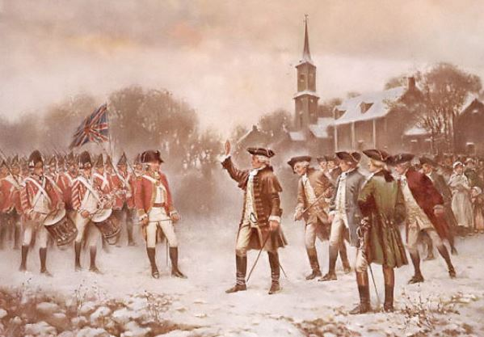
THE BRITISH ARMY IN THE COLONIES

Slide 9
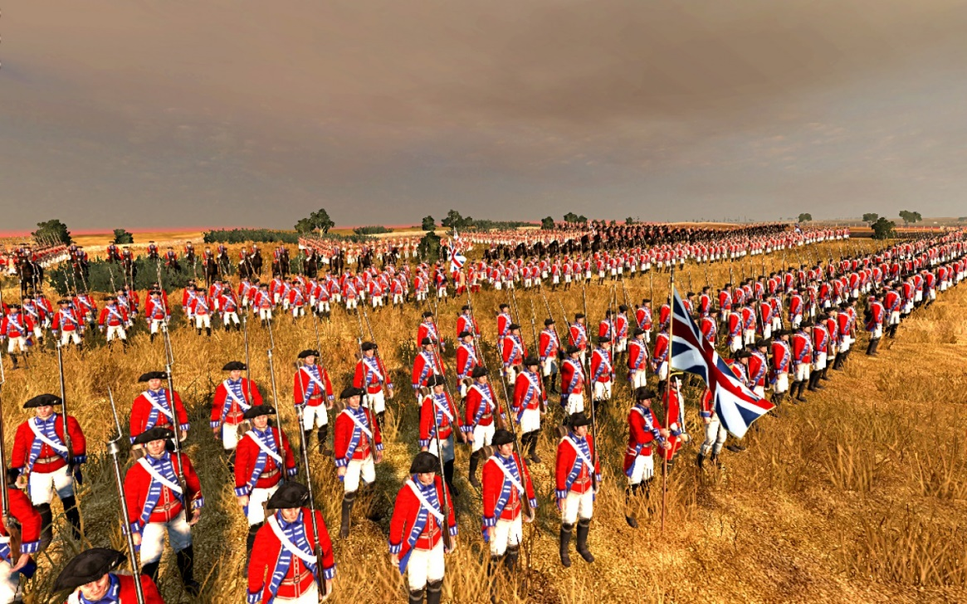
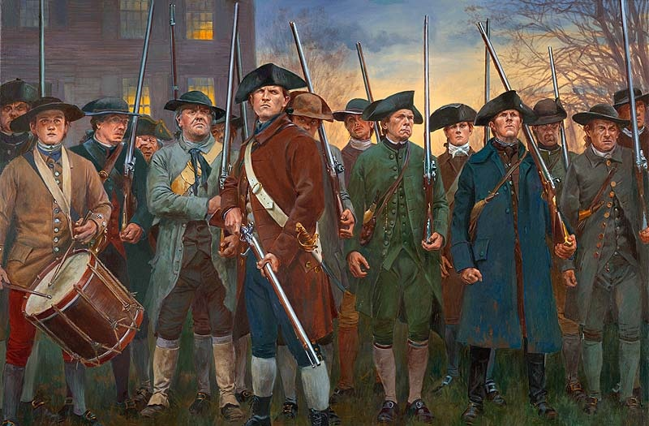
STANDING ARMY
CITIZEN MILITIA

Slide 10
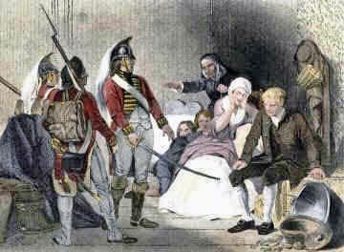
THE QUARTERING ACTS

Slide 11
The Third Amendment
No Soldier shall, in time of peace be quartered in any house, without the of the Owner, nor in time of war, but in a manner to be prescribed by law.

Slide 12
Excerpts from
The Declaration of Independence
“kept among us, in times of Peace, Standing Armies without the Consent of our legislatures”
“affected to render the Military independent of and superior to the Civil power.”

Slide 13
Excerpt from
English Bill of Rights
“raising or keeping a standing army within the kingdom in time of peace, unless it be with consent of Parliament, is against law.”

Slide 14
Founding Vision
The Second Amendment grew out of the popular belief in Founding-era America that standing armies posed a danger to liberty, and that the better way to defend the nation while preserving freedom was the militia, composed of all able-bodied men of fighting age in the community.

Slide 15
Excerpt from
English Bill of Rights
“subjects which are Protestants may have arms for their defence suitable to their conditions and as allowed by law”

Slide 16
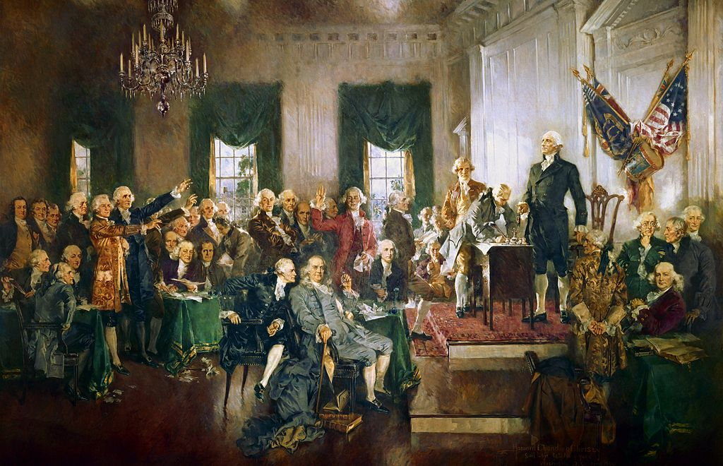
THE CONSTITUTIONAL CONVENTION

Slide 17
THE CONSTITUTION
Article I, Section 8
Congress shall have power…
To provide for calling forth the Militia to execute the Laws of the Union, suppress Insurrections and repel Invasions;

Slide 18
THE CONSTITUTION
Article I, Section 8
Congress shall have power…
To provide for organizing, arming, and disciplining, the Militia, and for governing such Part of them as may be employed in the Service of the United States, reserving to the States respectively, the Appointment of the Officers, and the Authority of training the Militia according to the discipline prescribed by Congress;

Slide 19
THE CONSTITUTION
Article I, Section 8
Congress shall have power…
To raise and support Armies, but no Appropriation of Money to that Use shall be for a longer Term than two Years;

Slide 20
THE CONSTITUTION
Article I, Section 8
Congress shall have power…
To provide and maintain a Navy;

Slide 21
DEBATES OVER STANDING ARMIES
In the debates over the Original Constitution, the Federalists (supporting the new Constitution) and the Anti-Federalists (opposing it) battled over the threat of standing armies and the scope of the national government’s power over national security and citizen militias.
With the new Constitution, the national government is given broad authority to establish a peacetime standing army and to regulate the militia.
The Constitution’s massive shift of power from the states to the national government in this context was a major objection to the new Constitution for the emerging Anti-Federalists.

Slide 22
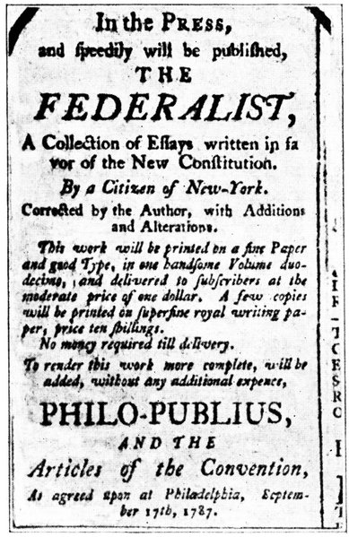
RATIFICATION DEBATES
In The Federalist Papers, both Hamilton and Madison addressed the issue of standing armies and the militia. The central idea behind Alexander Hamilton’s arguments was that the Constitution was necessary for national security reasons and thus standing armies were sometimes needed to secure the liberties of the people.

Slide 23
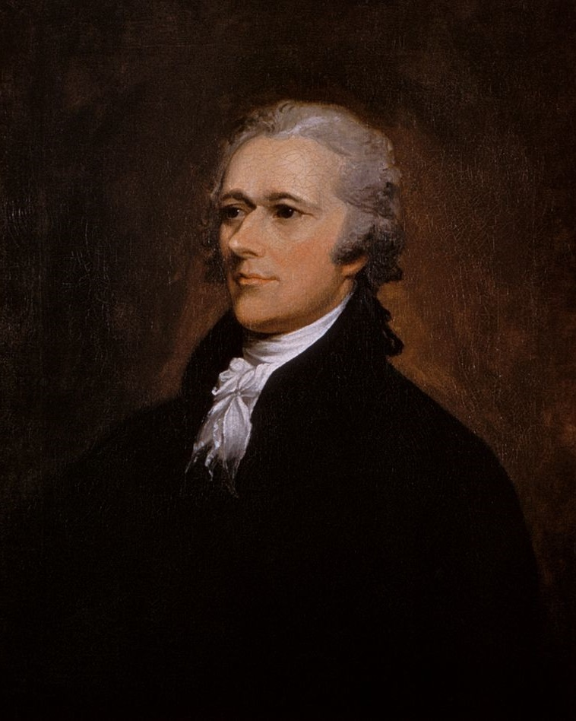
RATIFICATION DEBATES
For Hamilton, the American Revolution showed that we shouldn’t rely on state-organized militia for national defense.
ALEXANDER HAMILTON

Slide 24
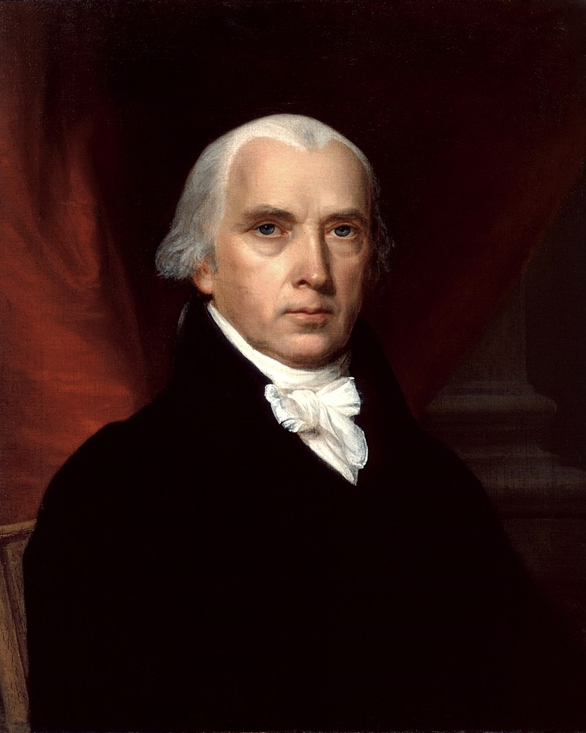
RATIFICATION DEBATES
James Madison tried to chart a middle course between Hamilton and the Anti-Federalists. Madison agreed that standing armies were an essential part of modern states and necessary to security. However, he added that what afforded Americans protection against foreign threats was not only a standing army, but the militia as well. Both were necessary to protect a free republic.
JAMES MADISON

Slide 25
RATIFICATION DEBATES
Madison’s Main Point:
The Anti-Federalist concerns about a national army overpowering the American people are probably overblown. The American people are almost impossible to subdue. American militias were big, and the American people were armed.
JAMES MADISON

Slide 26
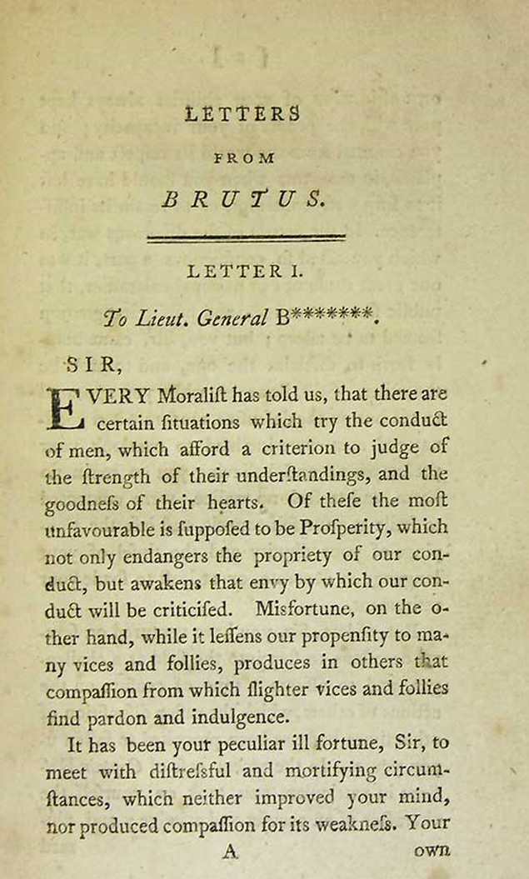
RATIFICATION DEBATES
At the same time, Anti-Federalist “Brutus” wrote many times about the anti-republican character of standing armies. For Brutus, the power of Congress to raise and support armies at its pleasure in times of peace and war and to control the militia evinced a tendency toward consolidation of government and “destruction of liberty.”
BRUTUS (THOUGHT TO BE NEW YORK’S ROBERT YATES)

Slide 27
RATIFICATION DEBATES
The Second Amendment responds to the Anti-Federalist fears that Congress might use its power to “organize, arm, and discipline” the militia as an excuse to disarm the American people.
The Second Amendment prevents this.

Slide 28
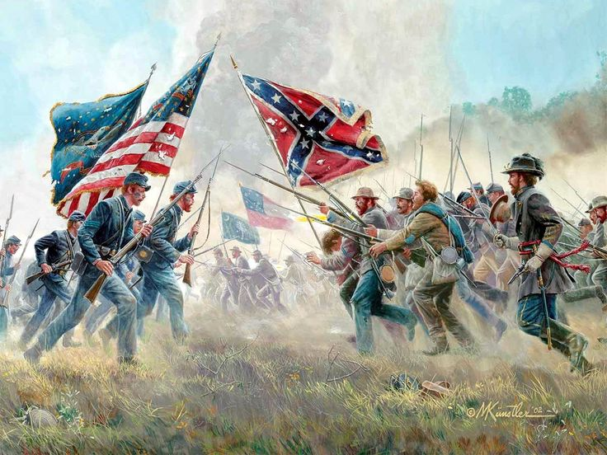
THE CIVIL WAR

Slide 29
THE CIVIL WAR AND RECONSTRUCTION
Framing Question:
How did the Civil War, Reconstruction, and the Second Founding transform debates over the Second Amendment and the right to keep and bear arms? And specifically, why were gun rights so important to African Americans in the South following the Civil War?

Slide 30
THE BLACK CODES
After the Civil War, white Southerners passed new laws—the Black Codes—which discriminated against African Americans and tried to impose the conditions of slavery on them again. As part of this move, these Black Codes tried to take away their arms.

Slide 31
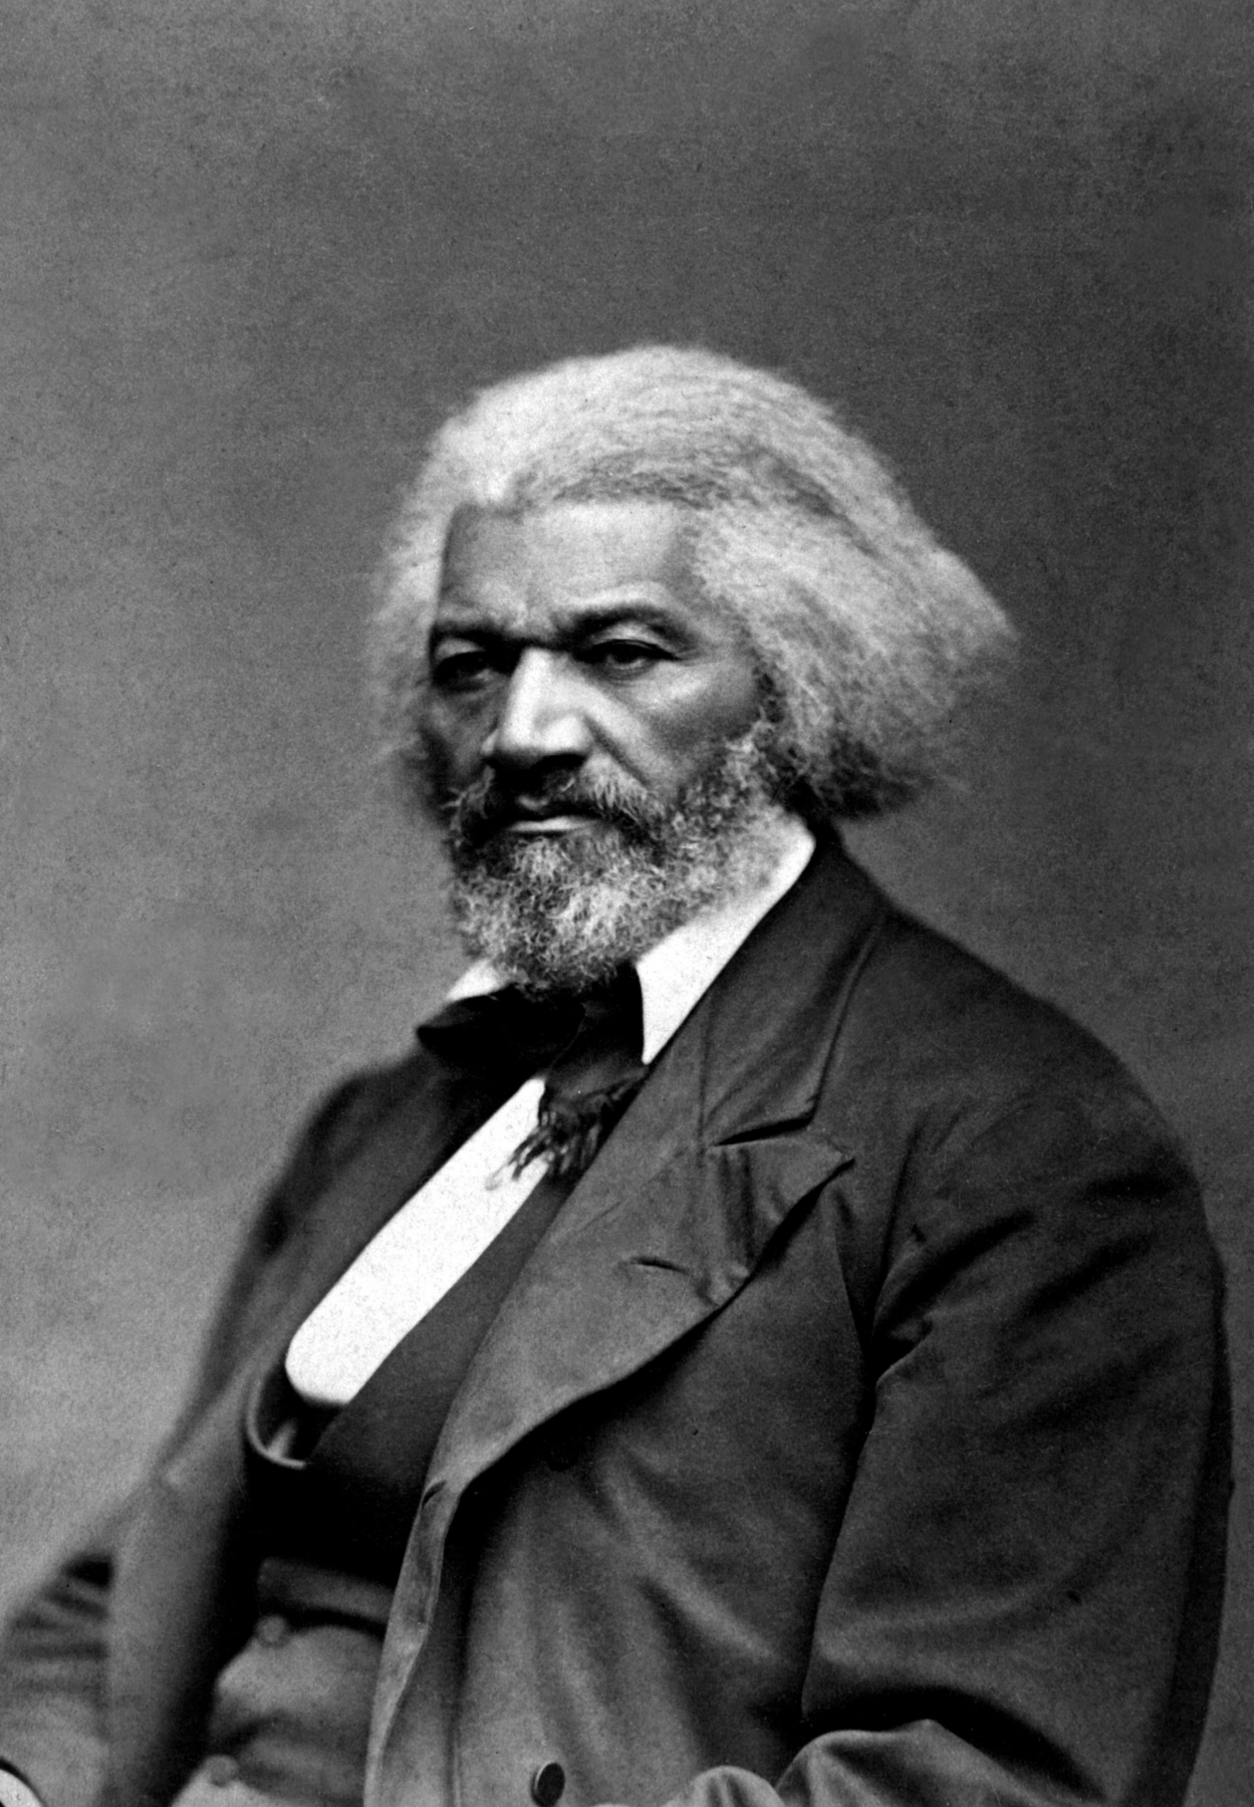
RESPONSE TO THE BLACK CODES
“The black man has never had the right either to keep or bear arms; and the legislatures of the states will still have the power to forbid it.”
FREDERICK DOUGLASS

Slide 32
RESPONSE TO THE BLACK CODES
“We, the people of the State of South Carolina, in Convention assembled, . . . ask that, inasmuch as the Constitution of the United States explicitly declares that the right to keep and bear arms shall not be infringed . . . that the late efforts of the Legislature of this state to pass an act to deprive us of arms be forbidden, as a plain violation of the Constitution.”
-Convention of African Americans in South Carolina

Slide 33
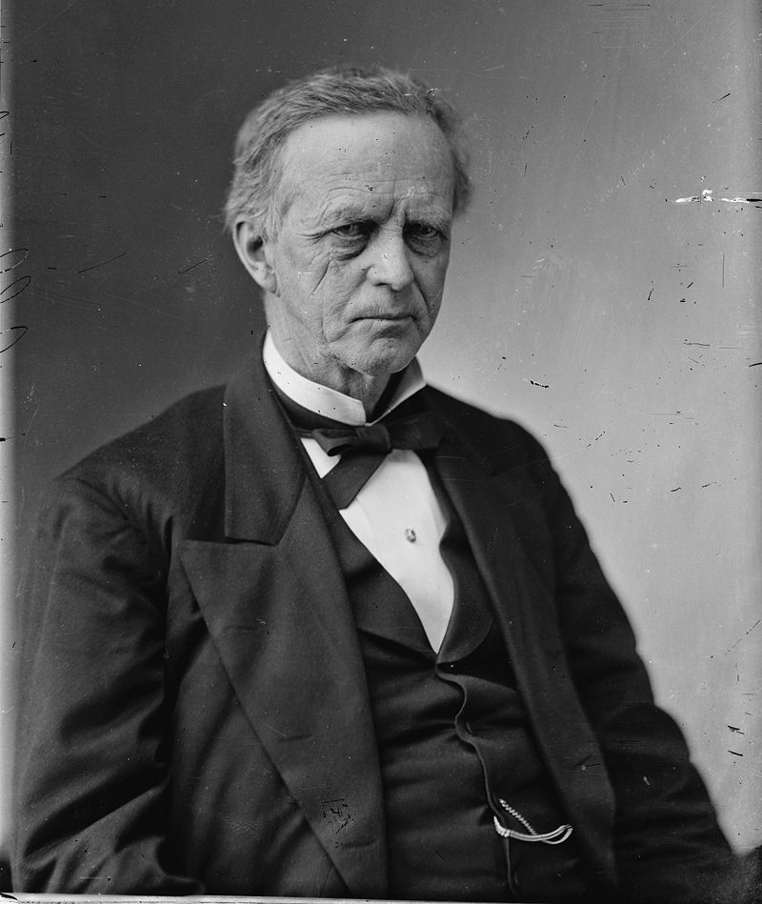
CIVIL RIGHTS ACT OF 1866
The Reconstruction Congress built new protections for African American gun rights into landmark laws like the Civil Rights Act of 1866.
Senator Lyman Trumbull specifically targeted a Mississippi law banning African Americans “from having fire-arms.”
LYMAN TRUMBULL

Slide 34
FREEDMAN’S BUREAU ACT
“laws . . . concerning personal liberty, personal security, and the acquisition, enjoyment, and disposition of estate, real and personal, including the constitutional right to bear arms, shall be secured to and enjoyed by all citizens.”;

Slide 35
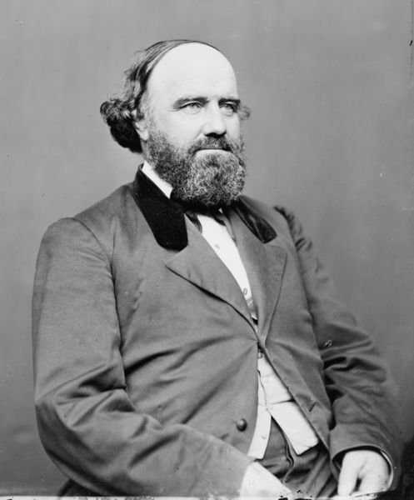
FREEDMAN’S BUREAU ACT
“If the cabin door of the freedman is broken open and the intruder enters for purposes as vile as were known to slavery, then should a well-leaded musket be in the hand of the occupant. . . . Every man . . . should have the right to bear arms for the defense of himself and his family and his homestead.”
SAMUEL POMEROY

Slide 36
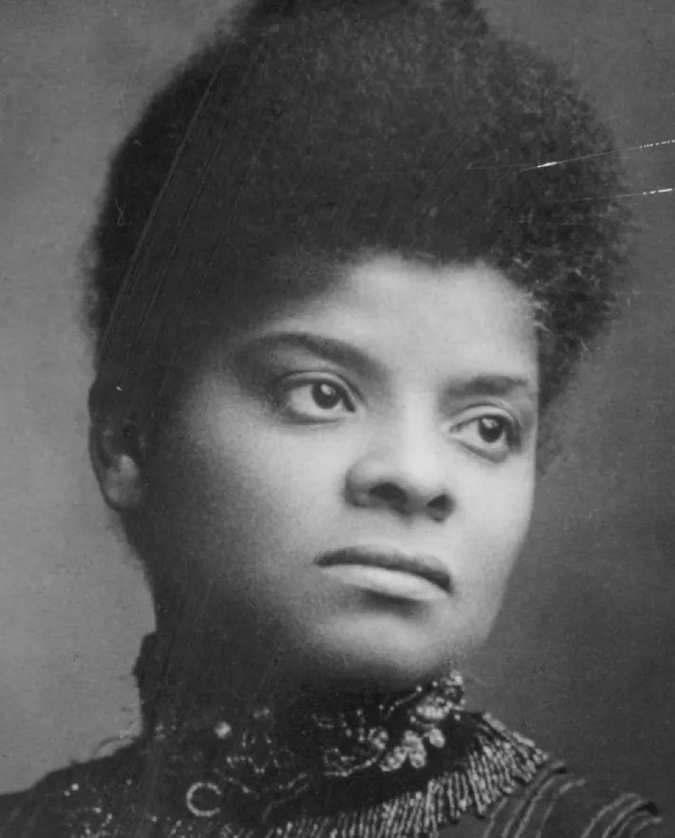
“[A] Winchester rifle should have a place of honor in every black home…When the white man…knows he runs as great a risk of biting the dust every time his African-American victim does, he will have a greater respect for African-American life.”
IDA B. WELLS

Slide 37
THE 14TH AMENDMENT (1868)
The 14th Amendment was ratified in 1868. In the ensuing decades, the Supreme Court would decide cases that limited its reach—including in the context of gun rights.
For instance, take United States v. Cruikshank (1876). This case arose out of one of the largest—if not the largest—incidents of white violence against African Americans during Reconstruction, the Colfax Massacre in April 1873. The incident takes place in Louisiana.

Slide 38
CRUIKSHANK V. UNITED STATES (1876)
Facts of the Case:
This case arose out of one of the largest—if not the largest—incidents of white violence against African Americans during Reconstruction, the Colfax Massacre in April 1873. The incident takes place in Louisiana. Both parties claimed victory after the election of 1872. Two Governors and two state legislatures claiming legitimacy. The two sides tried to take control of the Colfax Courthouse. The Republicans (including the local African American militia) succeeded in occupying it—reinforced by armed supporters. The militia began arming and drilling—with many African Americans armed with the rifles they had carried as Union soldiers.

Slide 39
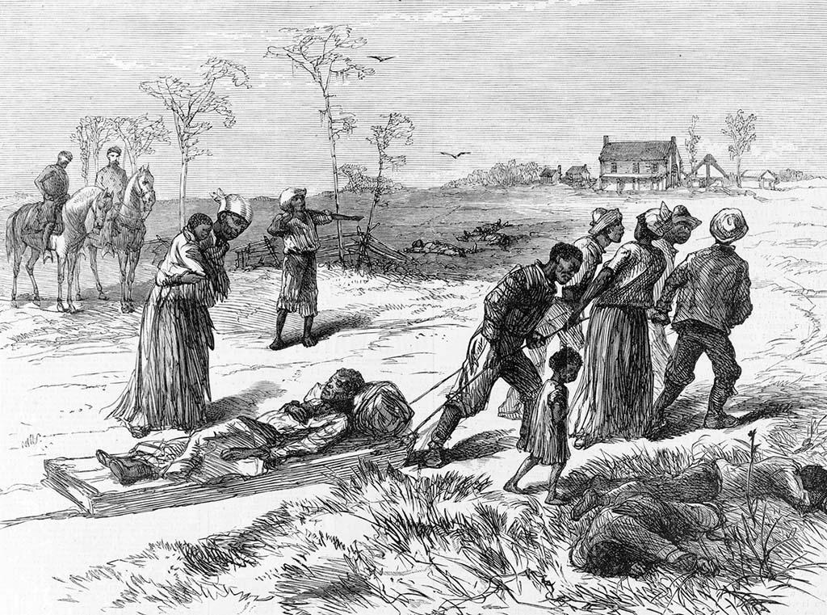
CRUIKSHANK V. UNITED STATES (1876)
On April 13, 1873, a white mob—led by the Ku Klux Klan—stormed the courthouse. All told, a group of 150 white people attacked the courthouse and eventually drove African Americans out of the building by setting fire to it. More than 100 African Americans were shot and killed as they fled the fire.
COLFAX MASSACRE

Slide 40
CRUIKSHANK V. UNITED STATES (1876)
The Outcome:
William Cruikshank and others were prosecuted for these murders under the Enforcement Act of 1870. They were charged with infringing many constitutional rights, including Second Amendment rights, and some of them were convicted.
The Court unanimously rules that the suit was improper—throwing out the indictments against the alleged murderers.

Slide 41
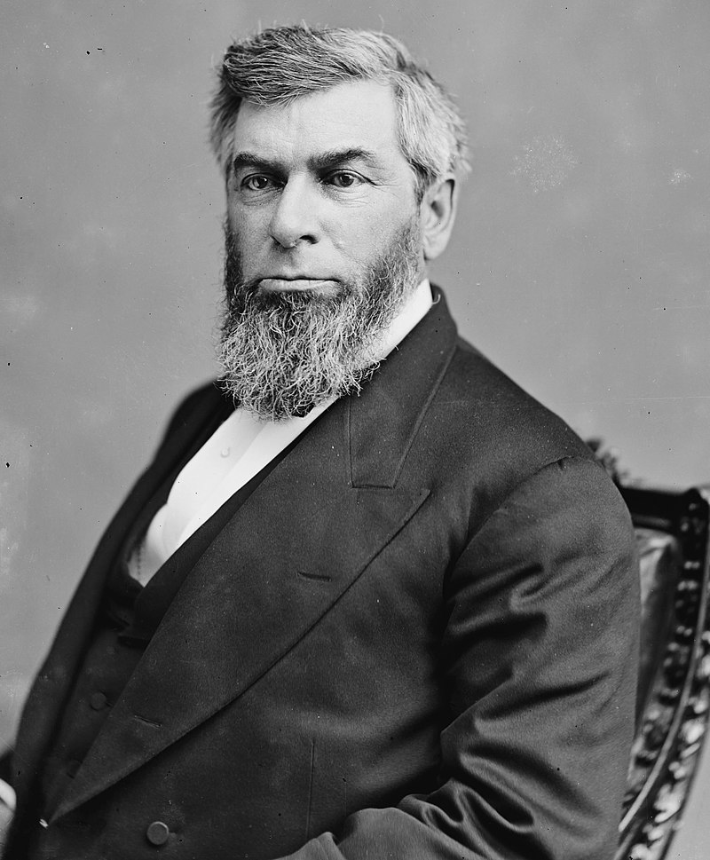
CRUIKSHANK V. UNITED STATES (1876)
Chief Justice Waite says that the national government does not have power to protect against Bill of Rights violations by private—as opposed to government—actors.
After all, the Fourteenth Amendment says “No state shall…” not “No one shall…” (Lawyers call this the “state action” requirement.)
CHIEF JUSTICE MORRISON WAITE

Slide 42
CRUIKSHANK V. UNITED STATES (1876)
“The right to bear arms is not a right granted by the Constitution nor does it depend on the constitution for its existence and the Second Amendment only restricts the powers of the national government.”
CHIEF JUSTICE MORRISON WAITE

Slide 43
HYPOTHETICAL
Can a city effectively ban handguns within city limits?
District of Columbia v. Heller (2008) and
McDonald v. City of Chicago (2010)
VOTE NOW!

Slide 44
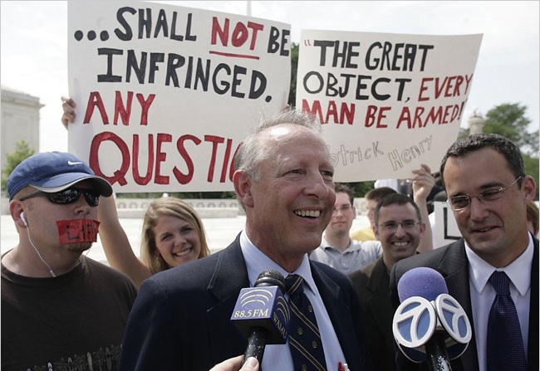
DISTRICT OF COLUMBIA V. HELLER (2008)
Facts of the Case:
The challengers argued that a District of Columbia law effectively banning handguns violated the Second Amendment. This case featured powerful originalist opinions—tackling the Second Amendment’s text and the Founding-era history—on both sides.
DICK HELLER

Slide 45
DISTRICT OF COLUMBIA V. HELLER (2008)
And the decision turned, in part, on the outcome of the debate over whether the Second Amendment protected a collective right (tied to militia service) or an individual right to keep and bear arms (that applied more generally).
If the collective rights side won, it would mean that governments had a great deal of discretion to regulate guns.
If the individual rights side won, it would mean that the Second Amendment might place limits on a range of gun regulations that limit the rights of individuals.

Slide 46
DISTRICT OF COLUMBIA V. HELLER (2008)
The Outcome:
The Supreme Court—in a 5-4 decision—endorsed the individual rights view. For the majority, the Second Amendment grants an individual right to keep and bear arms—including personal handguns in the home—subject to reasonable regulation outside of the home.
Justice Antonin Scalia authored the majority opinion. Scalia argued that it’s clear from the Founding-era history that words like “arms” and “bear” referred to individual rights to own commonly held (so, widely owned and used) firearms.

Slide 47
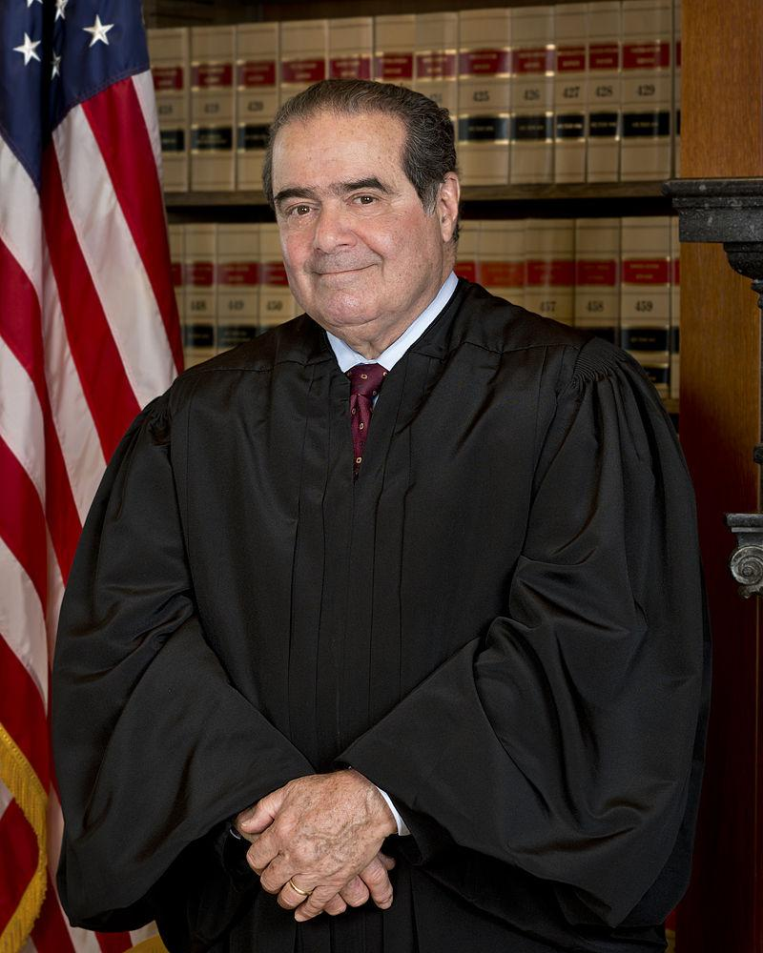
DISTRICT OF COLUMBIA V. HELLER (2008)
“Because a well regulated Militia is necessary to the security of a free State, the right of the people to keep and bear Arms shall not be infringed.”
JUSTICE ANTONIN SCALIA

Slide 48
Excerpt from
English Bill of Rights
“subjects which are Protestants may have arms for their defence suitable to their conditions and as allowed by law”

Slide 49
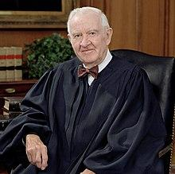
DISTRICT OF COLUMBIA V. HELLER (2008)
Dissenting: The “distinctly military Virginia proposal is therefore revealing, since it is clear that he considered and rejected formulations that would have unambiguously protected civilian uses of firearms.”
JUSTICE JOHN PAUL STEVENS

Slide 50
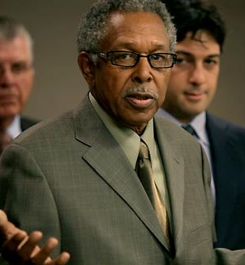
MCDONALD V. CHICAGO (2010)
Facts of the Case:
Since D.C. is not a state and is governed by federal law, the Supreme Court in Heller was simply asked to apply the Second Amendment directly. By challenging a similar handgun ban in Chicago, the McDonald case asked the key follow-up question: Does the 14th Amendment extend the Second Amendment’s key protections to state abuses? This question goes to the issue of “incorporation.”
OTIS MCDONALD

Slide 51
MCDONALD V. CHICAGO (2010)
The Outcome:
In a divided 5-4 decision, the Supreme Court concluded that the 14th Amendment did extend the Second Amendment’s key protections to state abuses—and struck down the Chicago handgun ban.
The Court held that the right to keep and bear arms for the purpose of self-defense was “deeply rooted” in the nation’s history. And the Second Amendment was thus incorporated against the states through the 14th Amendment—meaning that the states could not infringe on that right.

Slide 52
SECOND AMENDMENT CASES
These cases establish a core principle—The Second Amendment protects an individual right to gun possession for purposes of protecting one’s home. However, these cases also emphasize that the Second Amendment right isn’t absolute.
Importantly, Justice Scalia’s Heller opinion acknowledged “longstanding prohibitions on the possession of firearms by felons and the mentally ill, or laws forbidding the carrying of firearms in sensitive places such as schools and government buildings, or laws imposing conditions and qualifications on the commercial sale of arms.” It also limits Second Amendment rights to weapons in common use. So, the Heller Court affirmed the “historical tradition of prohibiting the carrying of ‘dangerous and unusual weapons.’” In other words, the Second Amendment might protect ordinary handguns, but not bazookas.

